Slide 1
The Maths Competition
By Ryan, Amraj, Ore and Ruth

Slide 2
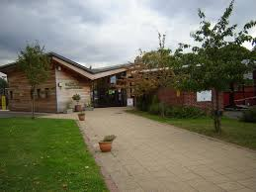
Where it was held?
The competition was held at Westlands Community Primary School

Slide 3
Schools
There were approximately 700 schools, 15 schools were competing in our round of the competition.

Slide 4
Rounds
There were four rounds of Maths questions. They were all about problem solving, our favourite was Algebra.

Slide 5
Were We Came?
Collingwood
Chipping Hill Primary
Chancellor Park
Barnes Farm Junior
We came one point away from 3rd
Some Schools put 2 teams in but we only put 1 team in for the competition because we didn’t think you could.
It was a tie so two teams had to go through.

Slide 6
Thank you for Watching

