Slide 1
Welcome To Year 3 - Parent Information Meeting

Slide 2
Year 3 classes
3R
Teacher: Mrs Rudgewick
LSAs: Mrs Knight
3J
Teacher: Miss Jackson
LSAs: Mr White, Mrs Al Zalek, Mrs Barrett and Mrs Berrisford
3CJ
Teachers: Mrs Cornforth (Mon-Weds) and Mrs Jordan (Thurs and Fri)
LSAs: Mrs Pedrick and Mrs Delgado
Student Teacher: Miss Betty
Year Group LSA: Mrs Sykes

Slide 3
Year 3 Curriculum Overview
In the mornings, we will be learning Maths (using the Mathematics Mastery scheme) and English.
Our topics…
Autumn – Were our prehistoric ancestors as clever as us?
Spring – Why is our local area great?
Summer – How can we look after our planet? Who were the Mayans?
Discover is a History-based topic, Explore is a Geography-based topic and Create is an Art-based topic. However, each of these topics will aim to incorporate a wide range of subjects including: PSHE, Science, DT, Computing, Music, RE and French.
PE will be taught within PPA sessions. SCS will be teaching Gymnastics, Netball, Football and more this year.

Slide 4
Year 3 enrichment opportunities
Visit to Chelmsford museum (Autumn Term).
Opportunities for cooking as part of Design and Technology.
Subject enrichment days throughout the year.
Opportunities for a further educational visit in the Spring and Summer Terms linked to the Environmental topic and the Mayans. More details to follow.

Slide 5
A Typical day
Maths
English
Maths Meeting/Handwriting/Tools Lesson
Foundation subjects (such as History, Geography, Science, Art, DT)
DEAR Time (Drop Everything And Read)
Daily mile or Green Bags

Slide 6
Children should bring to school each day:
Pupil passport
Reading book
Water bottle (named)
Healthy snack (e.g. fruit or vegetables) They are rewarded for this as it is important!
Waterproof coat

Slide 7
Behaviour For Learning
See behaviour for learning policy based on a restorative approach
Therapeutic approach
Secrets of Success underpins all we do in school; children collect stickers and bronze, silver and gold certificates.
Star of the week and celebration assembly in class
House Points
Class Marbles
Notes:
The school uses a simple, visual triangle for monitoring behaviour. This is highly visible in each classroom and in the hall and is used consistently throughout the school.
Gold – This is for children who go above and beyond in one of our ‘Secrets of Success’ traits . This will be noted by the teacher and will be linked to one of the 8 areas. A raffle ticket is earnt for the half termly draw.
Green – This represents our standard level of expectations for each child. Children begin every day in Green regardless of the day before.
Amber - If a child’s falls below our expectations of them, then their name may be moved into Amber. This gives the child a visual warning that they need to make better choices of behaviour. It will be accompanied by a reminder of the behaviour we are looking for. There may be an additional consequence to being moved into amber such as moving places in the classroom, kept behind at the end of a lesson. Children can move in and out of amber throughout the day.
Red - If the child’s name is placed in the red zone, it means that the child will receive a ‘red card’
and the parent will be informed that this has happened.

Slide 8
Home Learning Expectations
Homework is glued into the passports every Friday, see the homework section.
TTRS and other discrete timetable practice.
https://ttrockstars.com/
Reading - 10mins a day reading of their school book either independently or with an adult, 5 times or more a week (to be initialled in Pupil Passport by an adult). This is then calculated as a class reading % every week, as part of a school-wide competition.
Spellings – practise the spellings that are written in the Pupil Passport on a Monday morning. We will be testing the children weekly to support their progression with spellings. We are also practising some common exception words weekly.
Maths - CGP book (one task every week).
English Comprehension - CGP book (one task per fortnight).

Slide 9
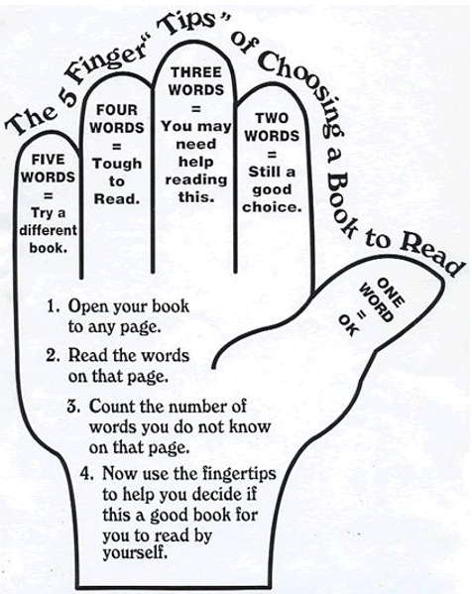
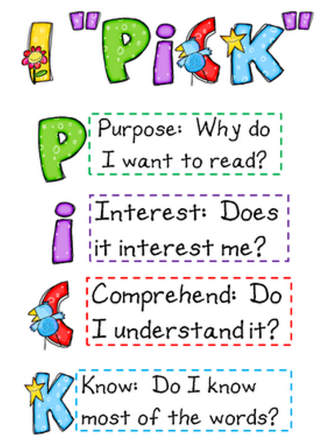
Reading Books
Books in the school library are sorted into levels which match the Essex Library’s levels. We assess the children‘s reading levels and they can choose a book from the proper level accordingly. A child should be able to self-assess their ability to access a book using the 5 Finger Strategy. This could include non-fiction. Children should be reading books that they can read confidently without support.
S books contain content suitable for all year groups. S+ books are aimed at Years 5 and 6.
Other levels include Y, L, P and O.
Children are given an opportunity to visit the library every week to change their book if needed.

Slide 10
Pencil Cases
Pencil cases are not needed in Year 3. However, if children do bring them in, they must be kept in their tray to prevent any distractions (with discretion of the teacher). They may be used during Art & DT. Children do not need any pens.
It is the children’s responsibility to look after any equipment from home.

Slide 11
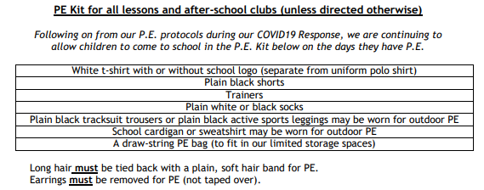
PE
PE will take place every Tuesday afternoon and every fourth week on a Friday afternoon. This will be made clear on the weekly newsletter and on the homework slips that are glued into passports.
In cold weather, children can wear a uniform or non-uniform sweatshirt. Please can all PE kit be clearly named.
Earrings: Must be removed for PE (Not taped over- this is a county policy). It is much easier if children come into school on PE days without earrings. Otherwise, children must be able to remove their earrings quickly & independently. If earrings cannot be removed, they cannot take part in PE.

Slide 12
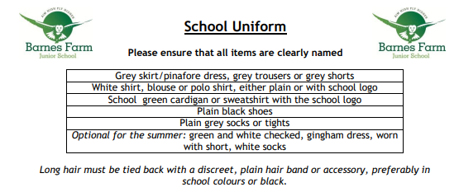
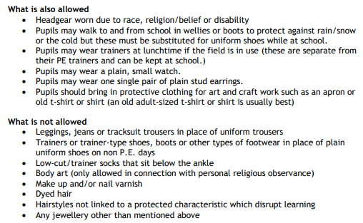
Uniform

Slide 13
Communication
There are communication pages in the Pupil Passport. We do not check these daily; please remind your children to show us any messages. Likewise, please ask your children in the evenings whether we have written notes home.
It is preferred that if you need private communication, send an email to remote support and it will be forwarded onto the class teacher: remotesupport@barnesfarm-jun.essex.sch.uk
The school try to be paper free where possible, please check that you are receiving the sent letters.

Slide 14
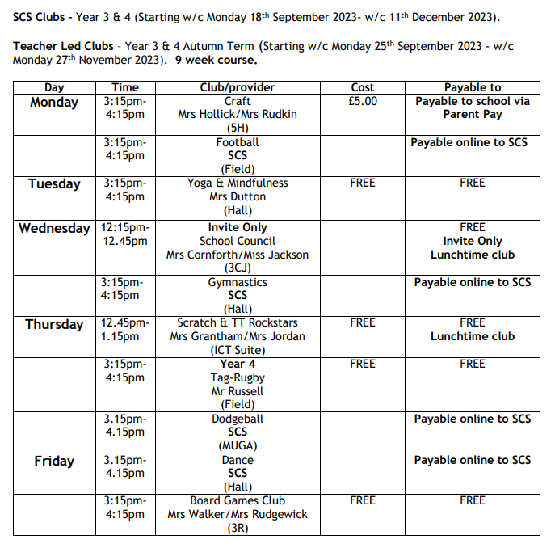
Clubs
BFJS offers a huge variety of clubs
including many offered by SCS.

Slide 15
Parent Consultations
There will be two Parent Consultation appointments during the Year. Further details to follow.
Outside of these times, appointments can be made with a class teacher via the school office or the remote support email if necessary.

Slide 16
Any questions?

