Slide 1
Parent Information Meeting
Year 5

Slide 2
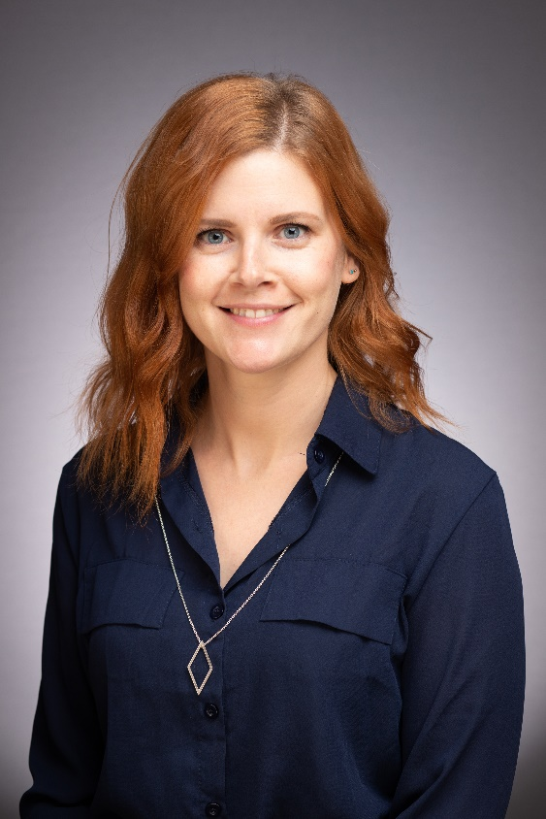
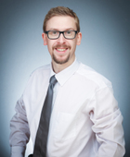
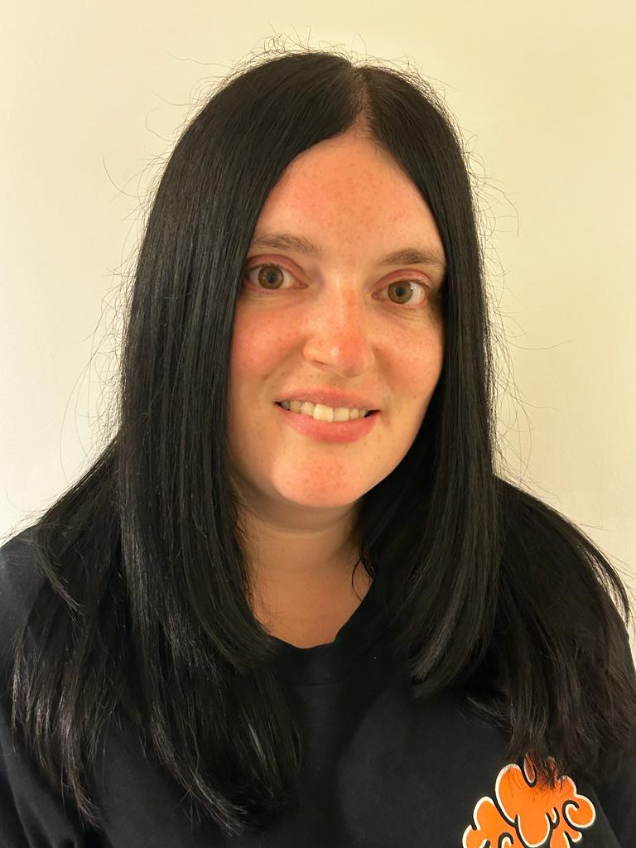
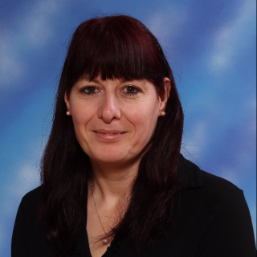
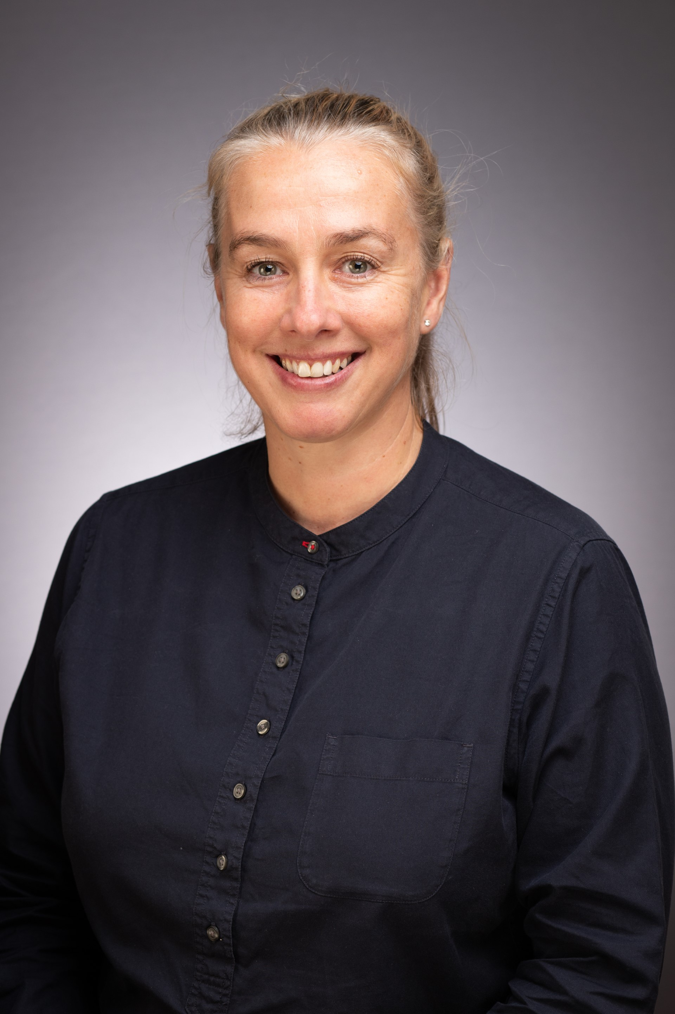
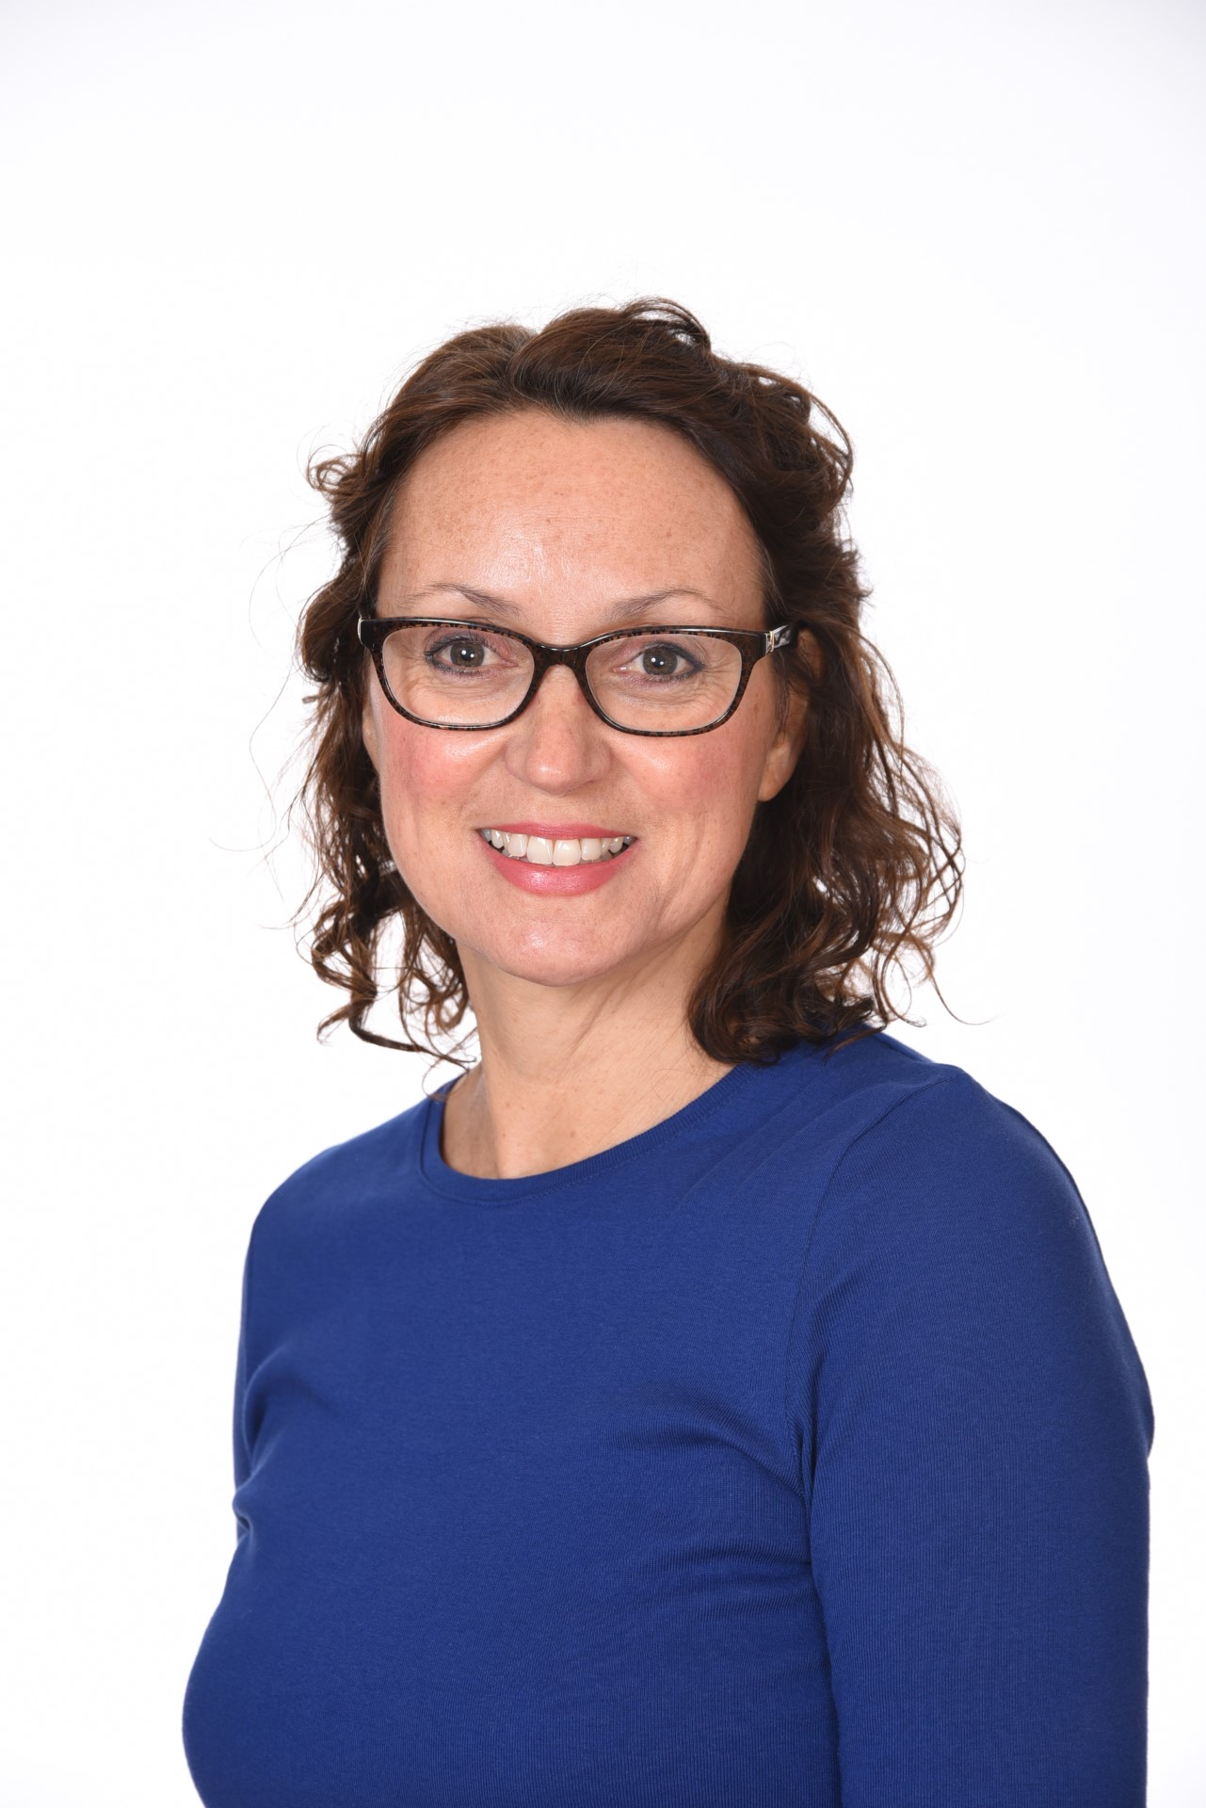
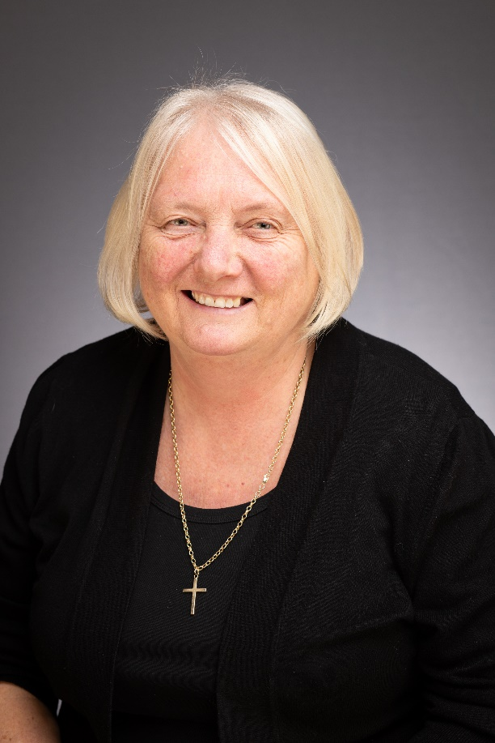
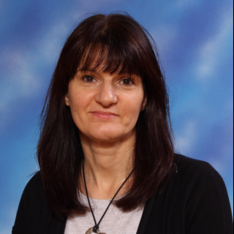
Staff
5H
5L
5A
Mrs Hollick
Mr Loveridge
Miss Albiston
Mrs Coxon Mrs Geddes Mrs Bardell Mrs Barrett Mrs Wye

Slide 3
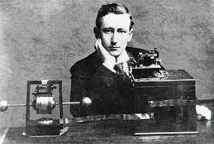
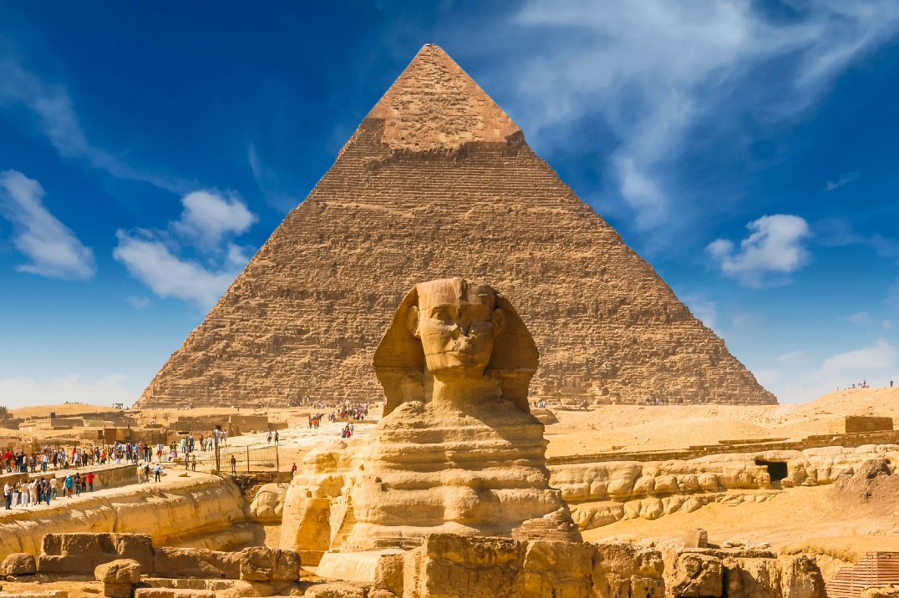
Overview of Topics
Spring Term
Chelmsford( birthplace of Radio)
Electrical Circuits
Living Things (cont.)
Autumn Term
Ancient Egypt
Materials
Living Things
Summer Term
Texas
Earth and Space
Notes:
Liz

Slide 4
Core Text
Autumn- Secrets of A Sun King by Emma Carroll
Spring- Kasper: Prince of Cats by Michael Morpurgo
Summer- Holes by Louis Sachar

Slide 5
Trips and in-school events
Trips: London – The British Museum
Chelmsford Museum- Marconi
Essex Police Museum- Crime and Punishment
Enrichment Day: Ancient Egypt experience
Titanic Experience Day
Texas Day
Secondary school visits in the Summer term- Sandon and Great Baddow
Notes:
Juliet

Slide 6
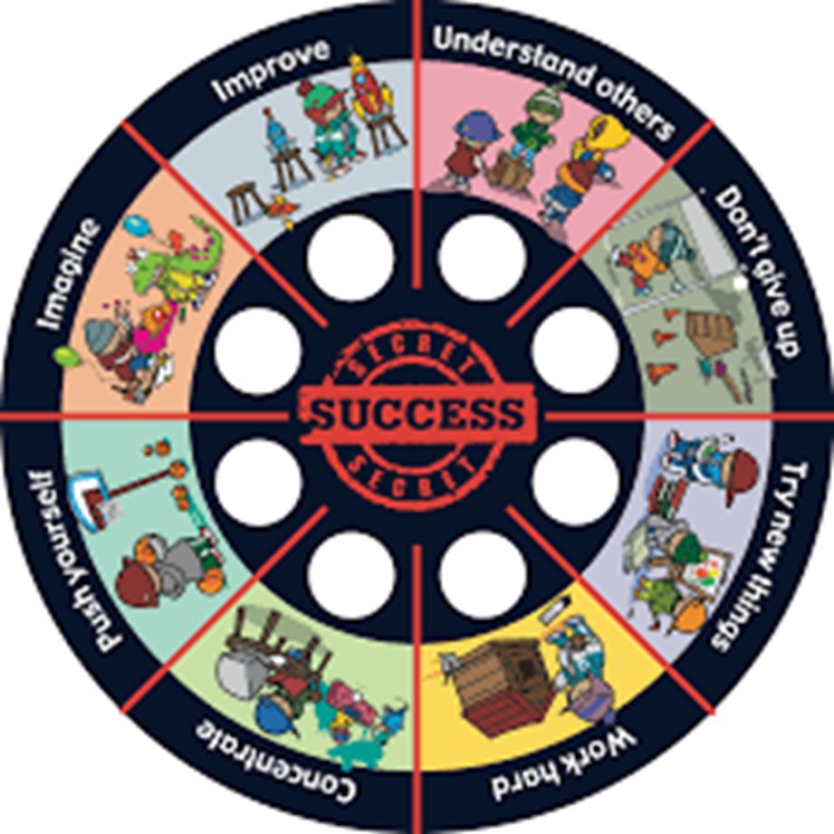
Behaviour for Learning
Class Marbles/Rewards
Secrets of Success
House points
Star of the Week
Notes:
Hannah

Slide 7
Home Learning
Year 5 Written Homework Expectations
Maths – 10-minute workout workbook,
1 double page to be completed every week. Pages set on Fridays (beginning Friday 22nd September).
English – One comprehension to be completed every other week. Pages set on Fridays (beginning Friday 15th September).
Written homework will be marked in EMW on Friday.
Reading: Children should read for at least 15 minutes per day, 5 times a week and record this in their pupil passport. Pupil passports should be signed weekly by a parent / carer.
Spellings: Practise weekly set spellings (recorded in pupil passport), including words of the week and any spelling patterns taught in class. This will be revisited in handwriting sessions.
Times Tables: practise multiplication and related division facts up to 12 x 12
Project
See separate letter.
Notes:
Hannah

Slide 8
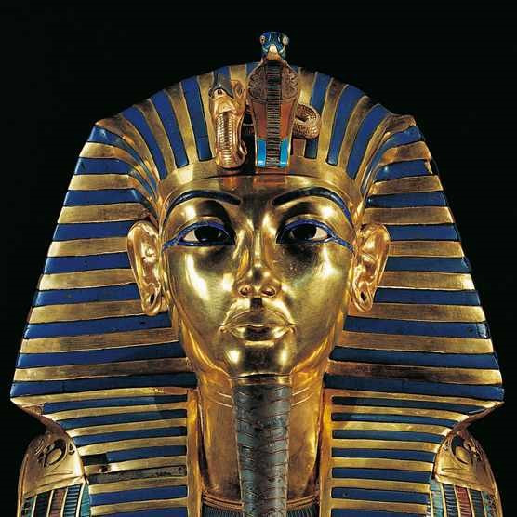
Home Learning
Our inquiry this term isWhat is the secret to a successful Ancient Egyptian afterlife? ​
​
This term we will focus on: the geography of Egypt and what life was like in Ancient Egypt, with a particular focus on the afterlife. ​
​We would like the pupils to complete a project focussing on an aspect of Egyptian life such as: ​
​
Religion ​
Pyramids ​
Stories (eg Moses and Tutankhamun etc.) ​
Family life ​
Mummification ​
Art ​
Hieroglyphics
​
Children can present their research in a variety of ways such as: PowerPoint, diary entries, information text, diagrams, 3D model or in any other form.
​
The project should be handed in by Friday the 12th of December. ​
We look forward to viewing your creation!

Slide 9
Reading Books
Books in the school library are sorted into levels which match the Essex Library’s levels. We assess the children‘s reading levels and they can choose a book from the proper level accordingly. A child should be able to assess their ability to access a book using the 5 Finger Strategy. This could include non-fiction. Children should be reading books that they can read confidently without support.
S books contain content suitable for all year groups. S+ books are aimed at Years 5 and 6.
Year 5 can change their book in the library during their class’s slot on a Monday or Friday. They will now be checking their book out on a library computer system, so one book must be returned before they can take another one. One book can be borrowed at a time.
Children have a genre wheel in their Pupil Passports and are encouraged to read a variety of books from different genres.
Notes:
Liz

Slide 10
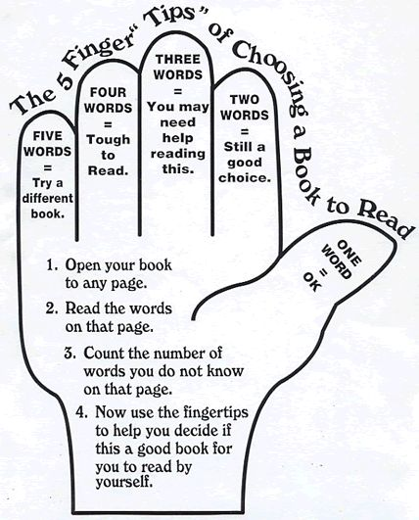
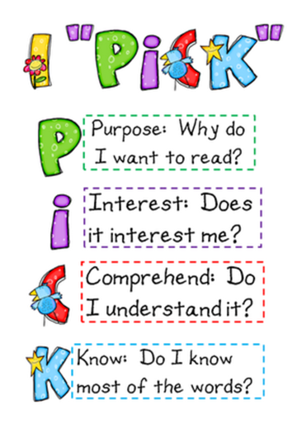
Reading Books
Notes:
Liz

Slide 11
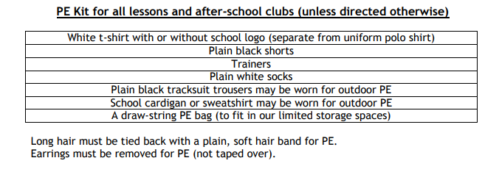
PE
Outdoor PE Thursday and every 4th Friday, beginning the 29th September. This information is also in the weekly Newsletter.
Children can come to school in PE kit on those days.

Slide 12
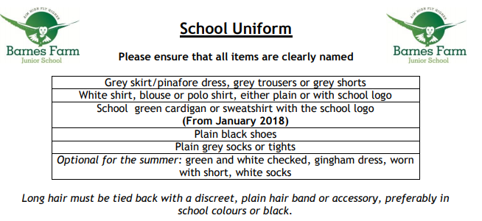
Uniform

Slide 13
How to keep in touch
Communication sheets in back of Pupil Passport
Message to LSA on door, early morning
Make an appointment via office if necessary.
Emails to – Remotesupport@barnesfarm-jun.essex.sch.uk
Report illness via studybugs and follow covid guidance on school website.

