Slide 1
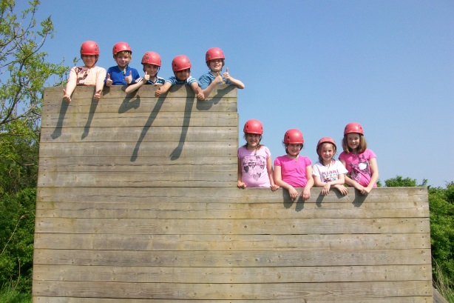
Mersea 2015 For more info visit www.essexoutdoors.org/mersea.php
Mon 18th to Weds 20th May 2015
Parents Meeting 03/02/2015

Slide 2
Why go outdoors?
Pupils are exhilarated by the experience of achieving their goals having successfully worked outside of their comfort zone.
This provides them with the confidence to tackle uncertainty and challenges elsewhere in their personal, school and working lives, thereby realising more of their potential

Slide 3
Why Mersea?
It is local
We have been there before and know the provision is good
Part of Essex Outdoors Adventurous Activities Licensing Authority approved (AALA)
All staff have had CRB, safeguarding and first aider training. Staff on duty 24 hours a day

Slide 4
Why did it change last year?
Reviewed what we wanted to achieve and listened to feedback
Too crammed and vulnerable to weather
1 night residential - children staying up late then getting up early!
Was a success! New tents for 2015

Slide 5
Format of trip 2015
Monday 18th May
Arrive at school as usual
Depart mid morning
Arrive at site and set-up
Lunch
Activity 1 + 2
Dinner
Evening Activity 3

Slide 6
Format of trip 2015
Tuesday 19th May
Breakfast
Activity 4
Lunch
Activity 5 and 6
Dinner
Evening Activity organised by school staff

Slide 7
Format of trip 2015
Wednesday 20th May
Breakfast
It’s a Knockout activity
Pack-up
Lunch
Leave and arrive back at school for normal time depart
Thursday normal day

Slide 8
Other Information
Staffing – HT and DH attending plus parent helpers identified
Parental consent form
Medical information
Discuss sensitive issues well in advance
Kit list – do not buy lots of new stuff!

Slide 9
Other key information
Equipment
Medication
Communication
- School Mobile 24/7
- Twitter
Any questions?

