Slide 1
Can you guess who the bookshelf belongs to?

Slide 2
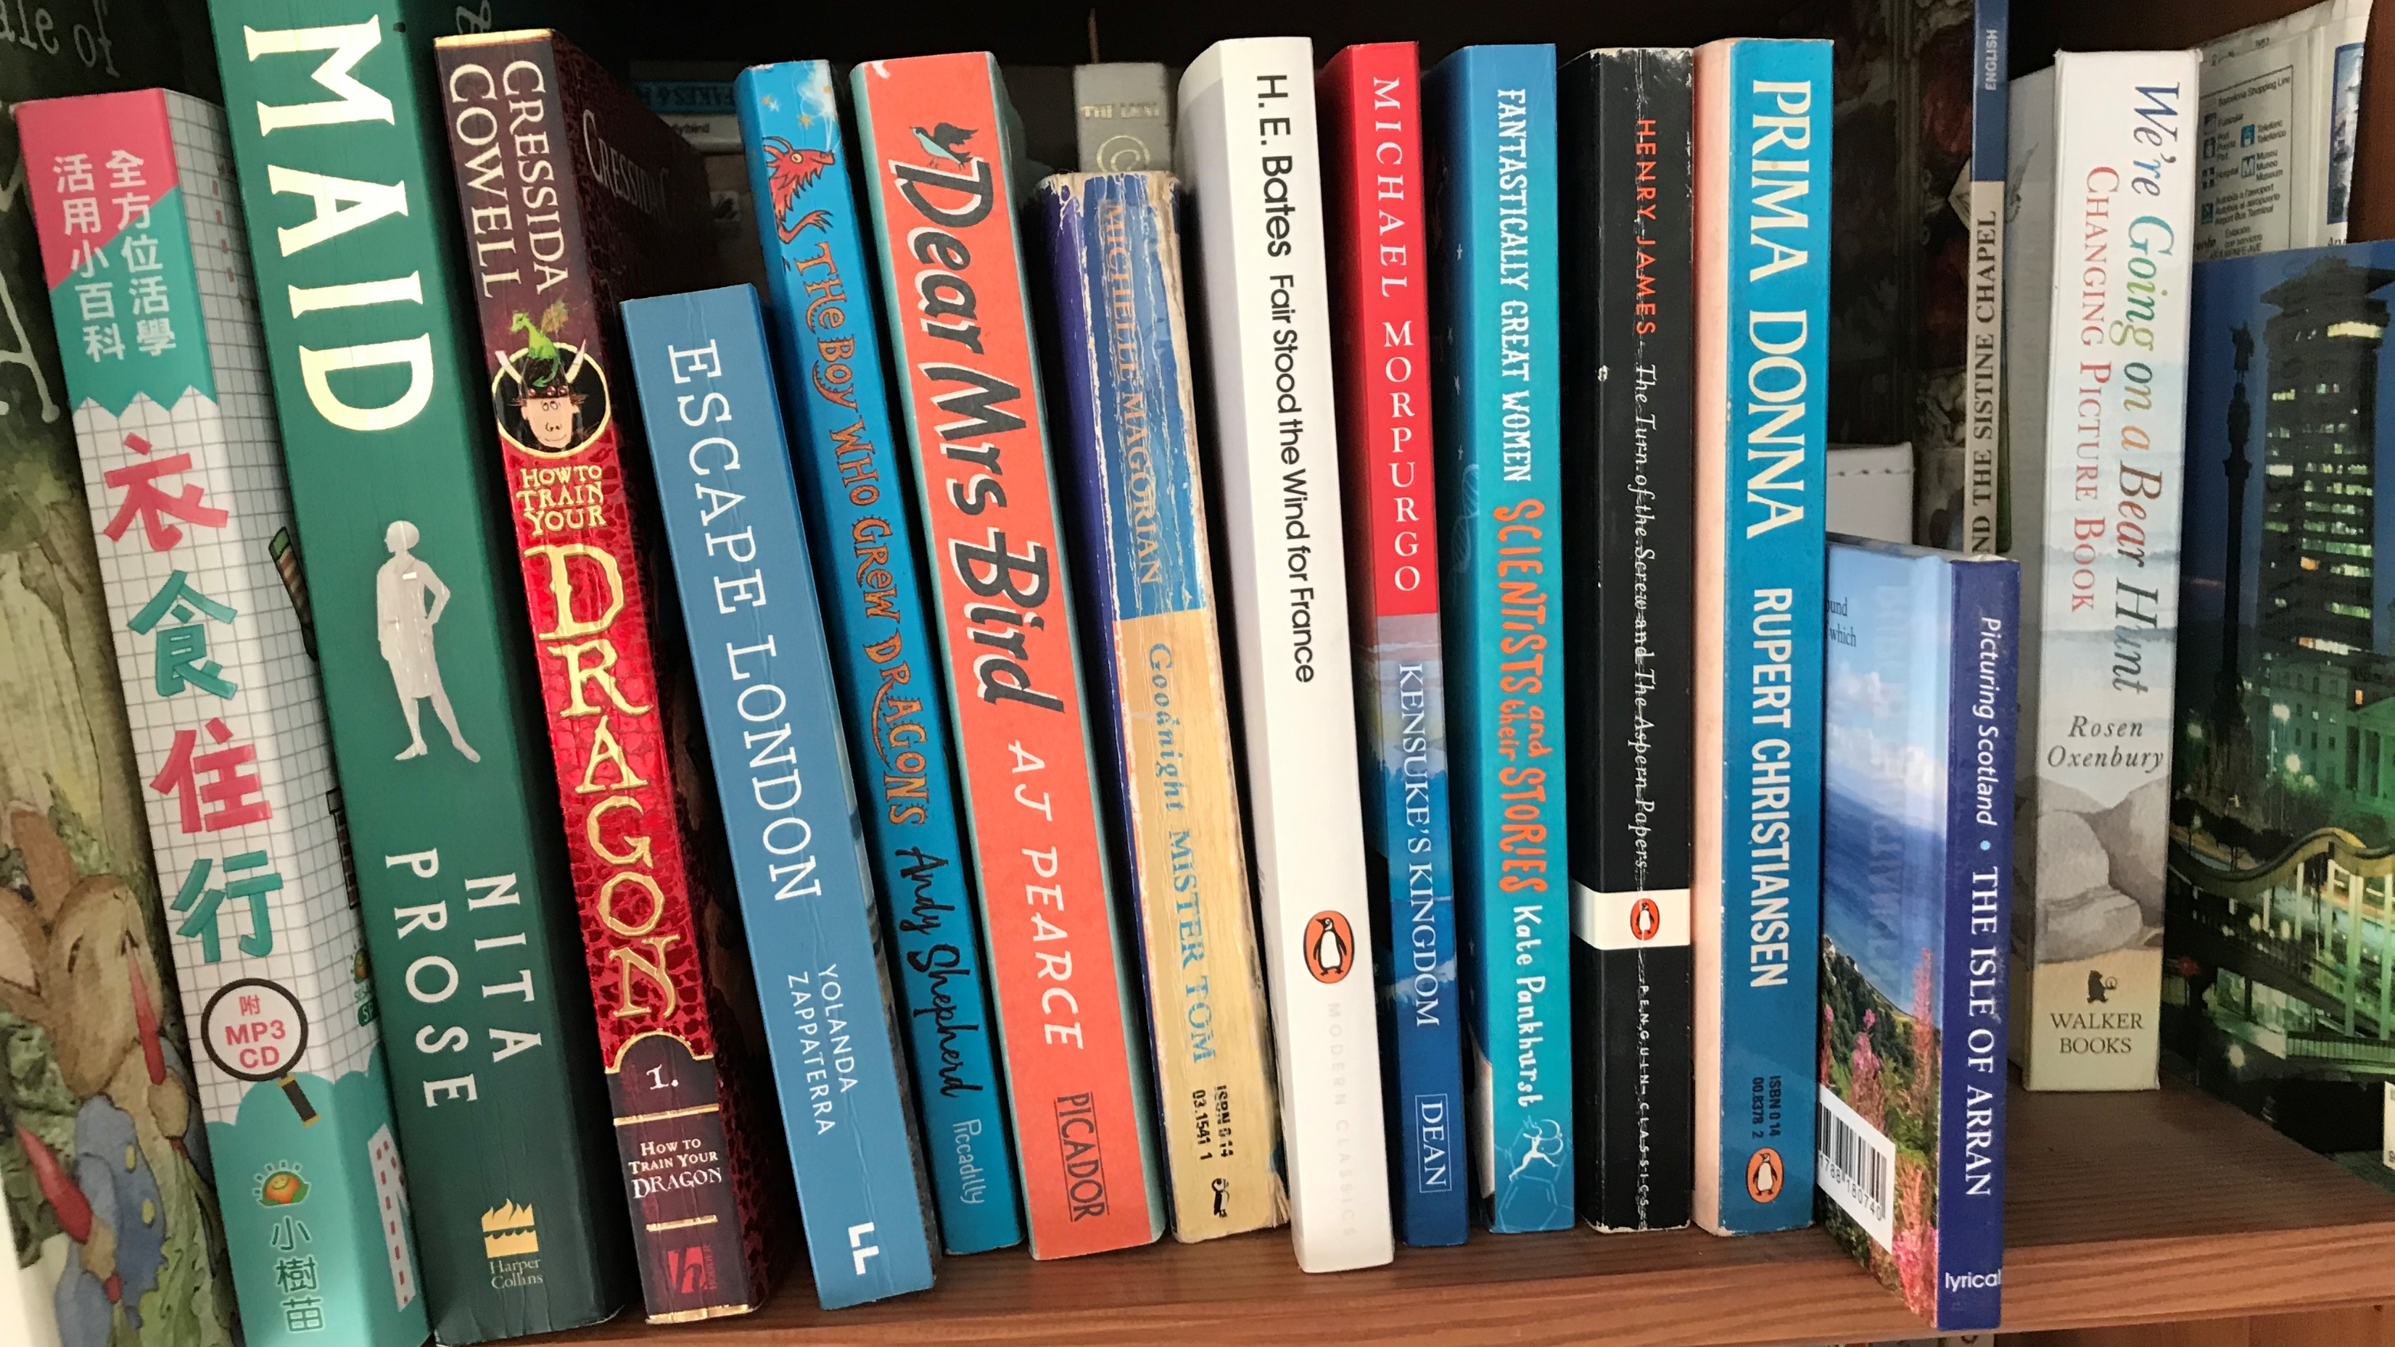
CLUE: This teacher must have young children but also looks as though she has been learning to speak a different language. Can you spot the copy of a year 4 core text as well?...
Notes:
Nicola F

Slide 3
CLUE: This teacher is clearly a Lord of the Rings and DC comics fan...
Notes:
Adam L

Slide 4
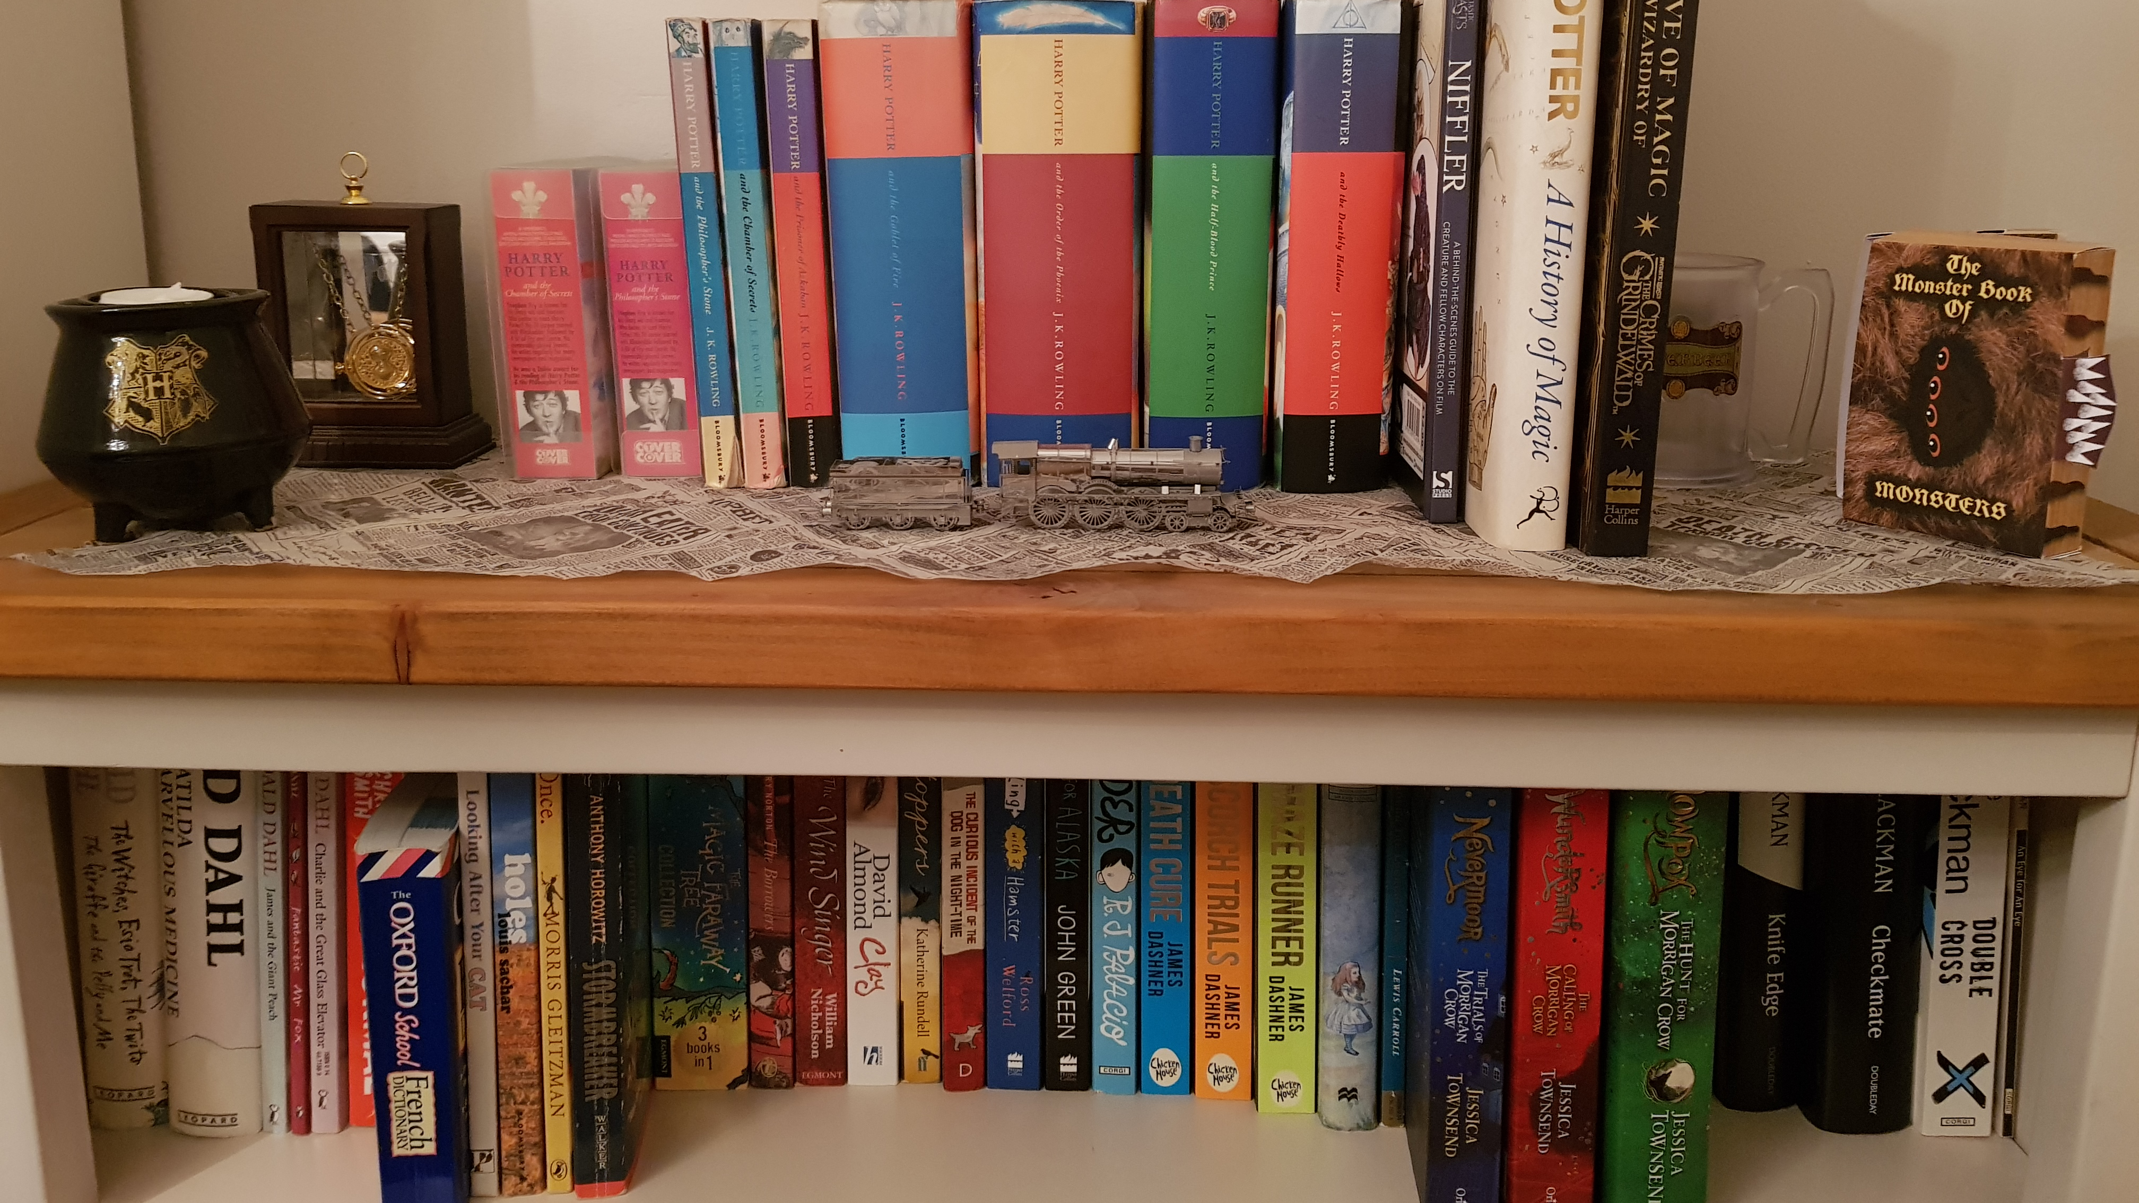
CLUE: This teacher is a huge Harry Potter fan and has previously dressed up as Hermonie Granger on World Book Day. Can you spot the core texts from years 5 and 6? Maybe this teacher has taught in both these year groups recently....
Notes:
Jess

Slide 5
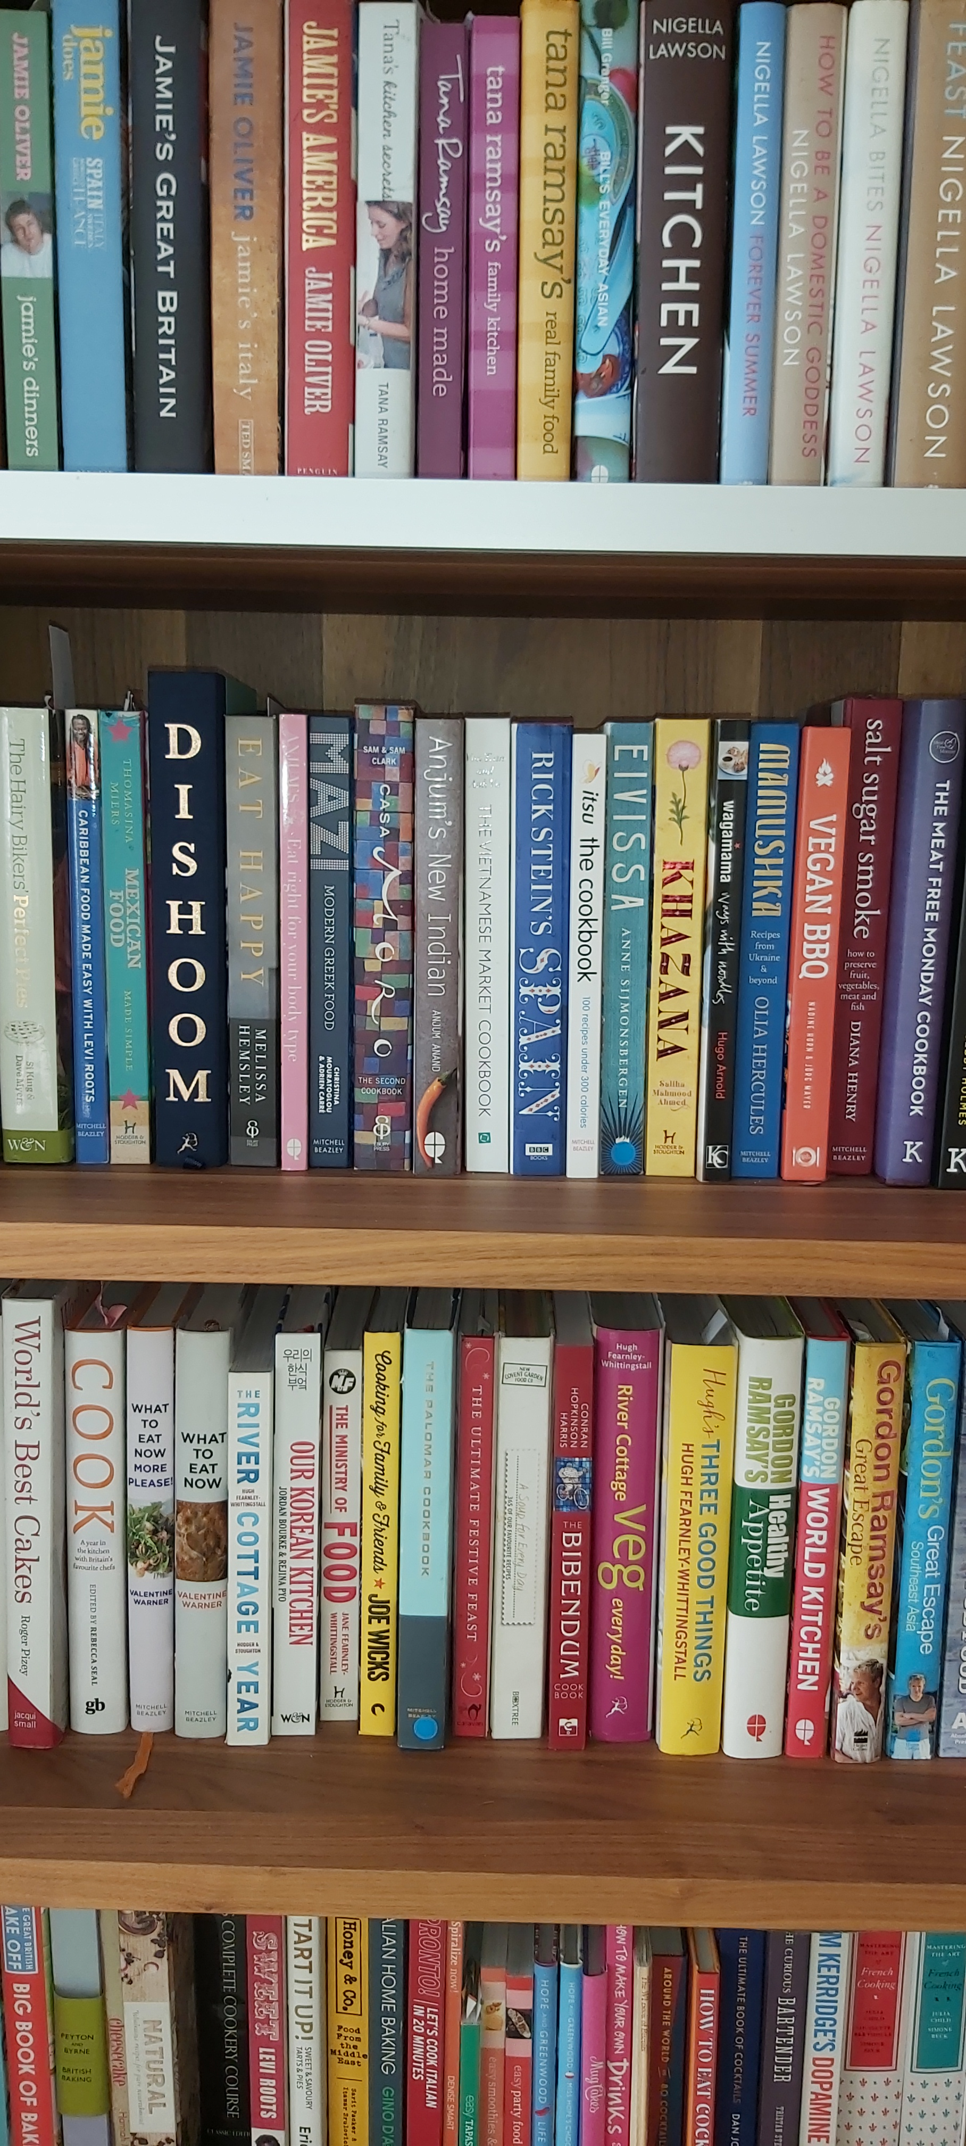
CLUE: This LSA clearly enjoys cooking for her family, which includes her 3 teenage daughters...
Notes:
Sarah Geddes

Slide 6
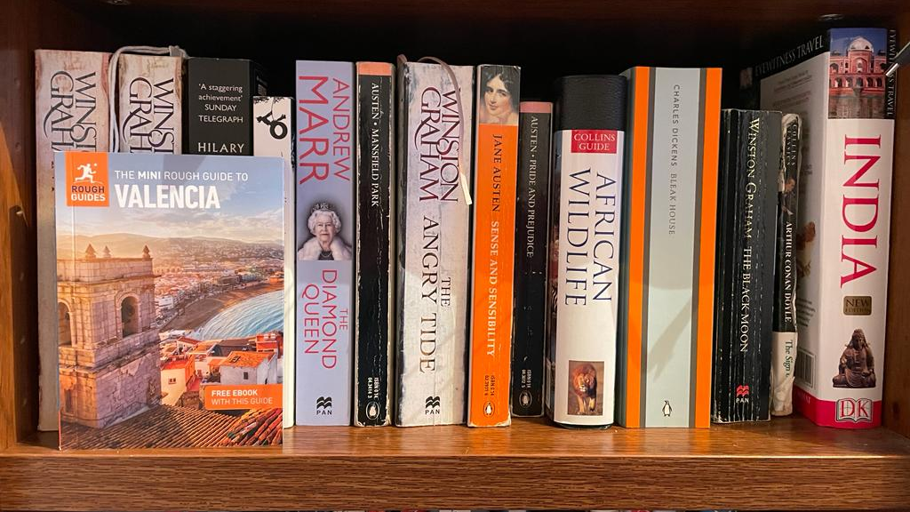
CLUE: This teacher has recently booked a holiday to Valencia for the next half term break... can you tell she's excited?...
Notes:
Jane Cole

Slide 7
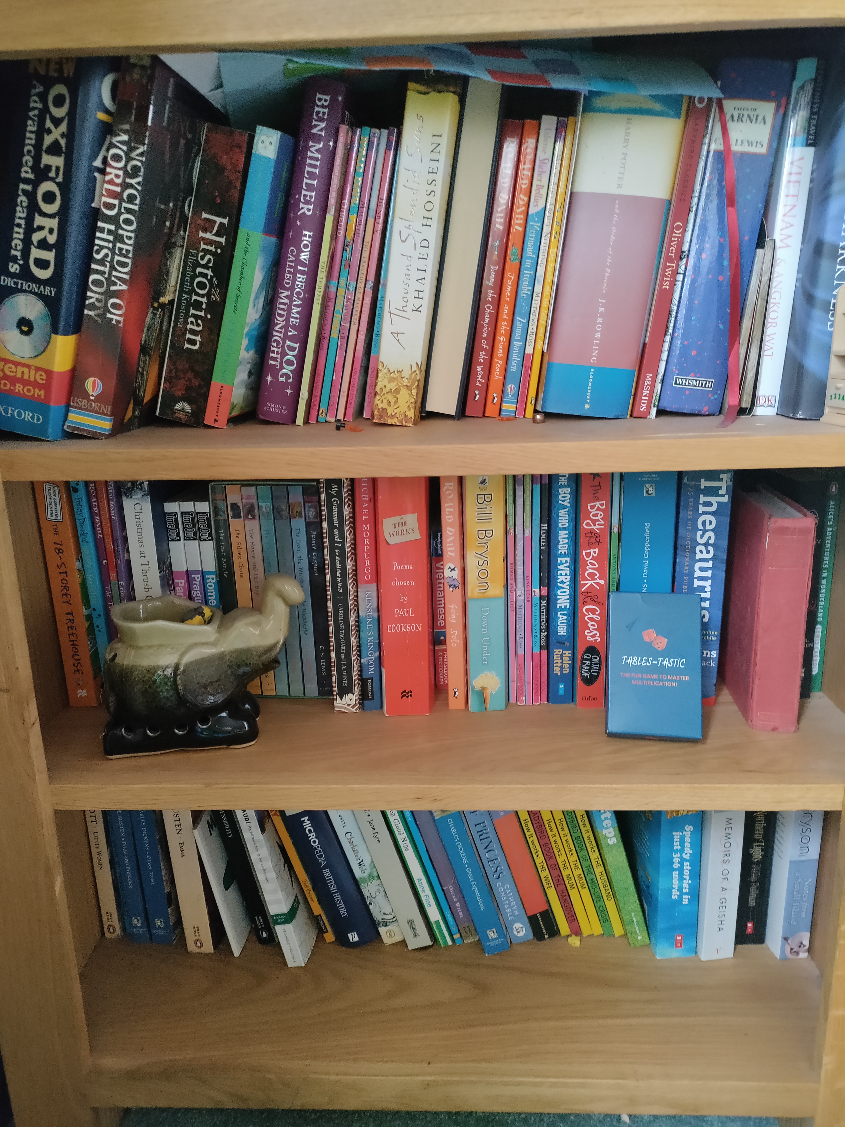
CLUE: This bookshelf used to belong to this teacher until her two daughters became confident book worms. Now it's full of lots of different books. This teacher loves to read, so if she can, she likes to sit with a book on Thursdays or Fridays (she's not in school those days). This teacher is also thinking of using the multiplication game with her maths club...can you guess whose bookshelf this is?
Notes:
Debbie

Slide 8
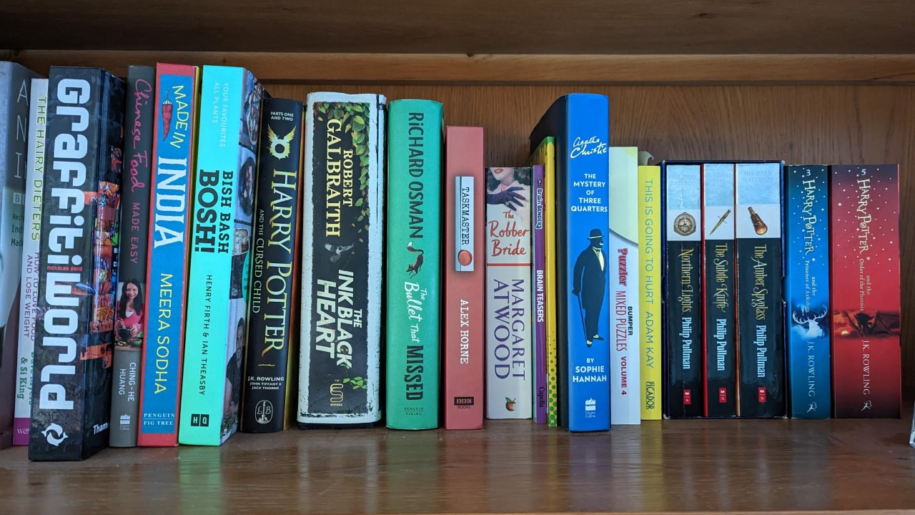
CLUE: This teacher is also a huge Harry Potter fan and has previously dressed up as Dolores Umbridge and Patricia Trelawney on World Book Day.
Notes:
Jemma

Slide 9
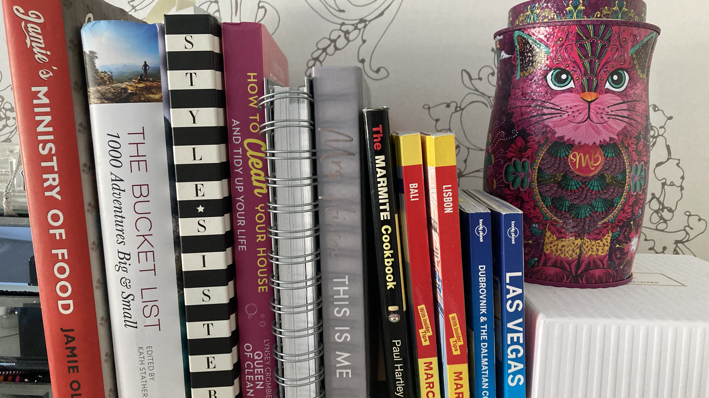
CLUE: This teacher has lots of travel books so she must love to travel and explore different countries. She has recently been to Dubai on holiday. She is also going to Las Vegas in May half term – quite the jetsetter! It looks as though she may like cats as well...
Notes:
Juliet

Slide 10
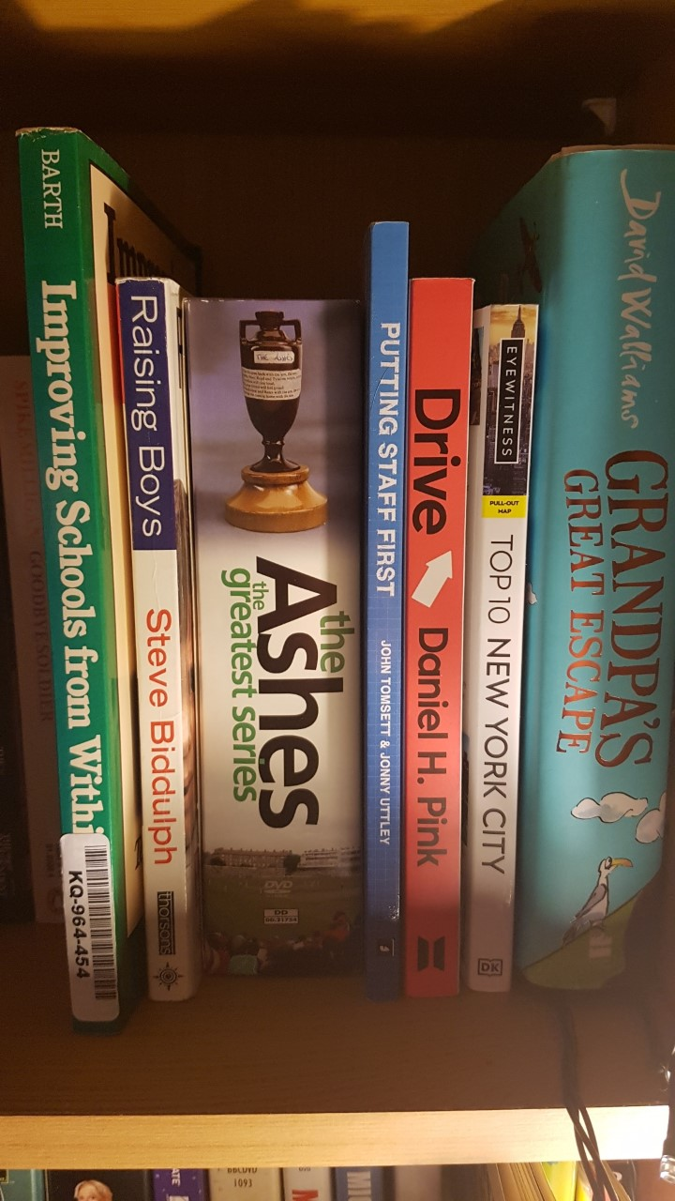
CLUE: This 'teacher' enjoys watching the cricket when he's not busy working on school improvement...
Notes:
Ross

Slide 11
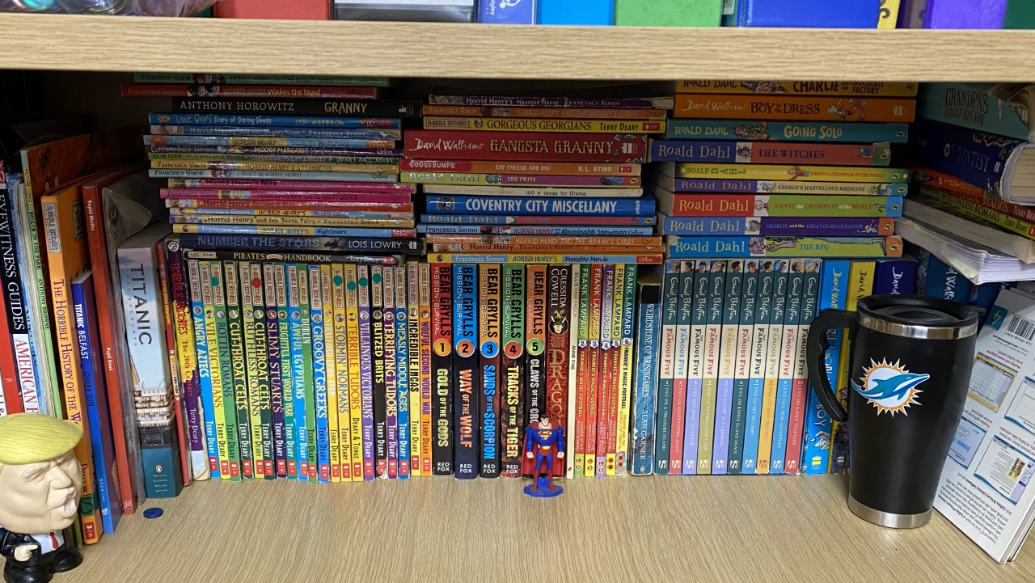
CLUE: This looks like a bookshelf in one of the classrooms. Can we guess which one? The teacher has left a few cryptic clues... have you seen him carrying this coffee mug around school?
Notes:
Adam/ 5W

Slide 12
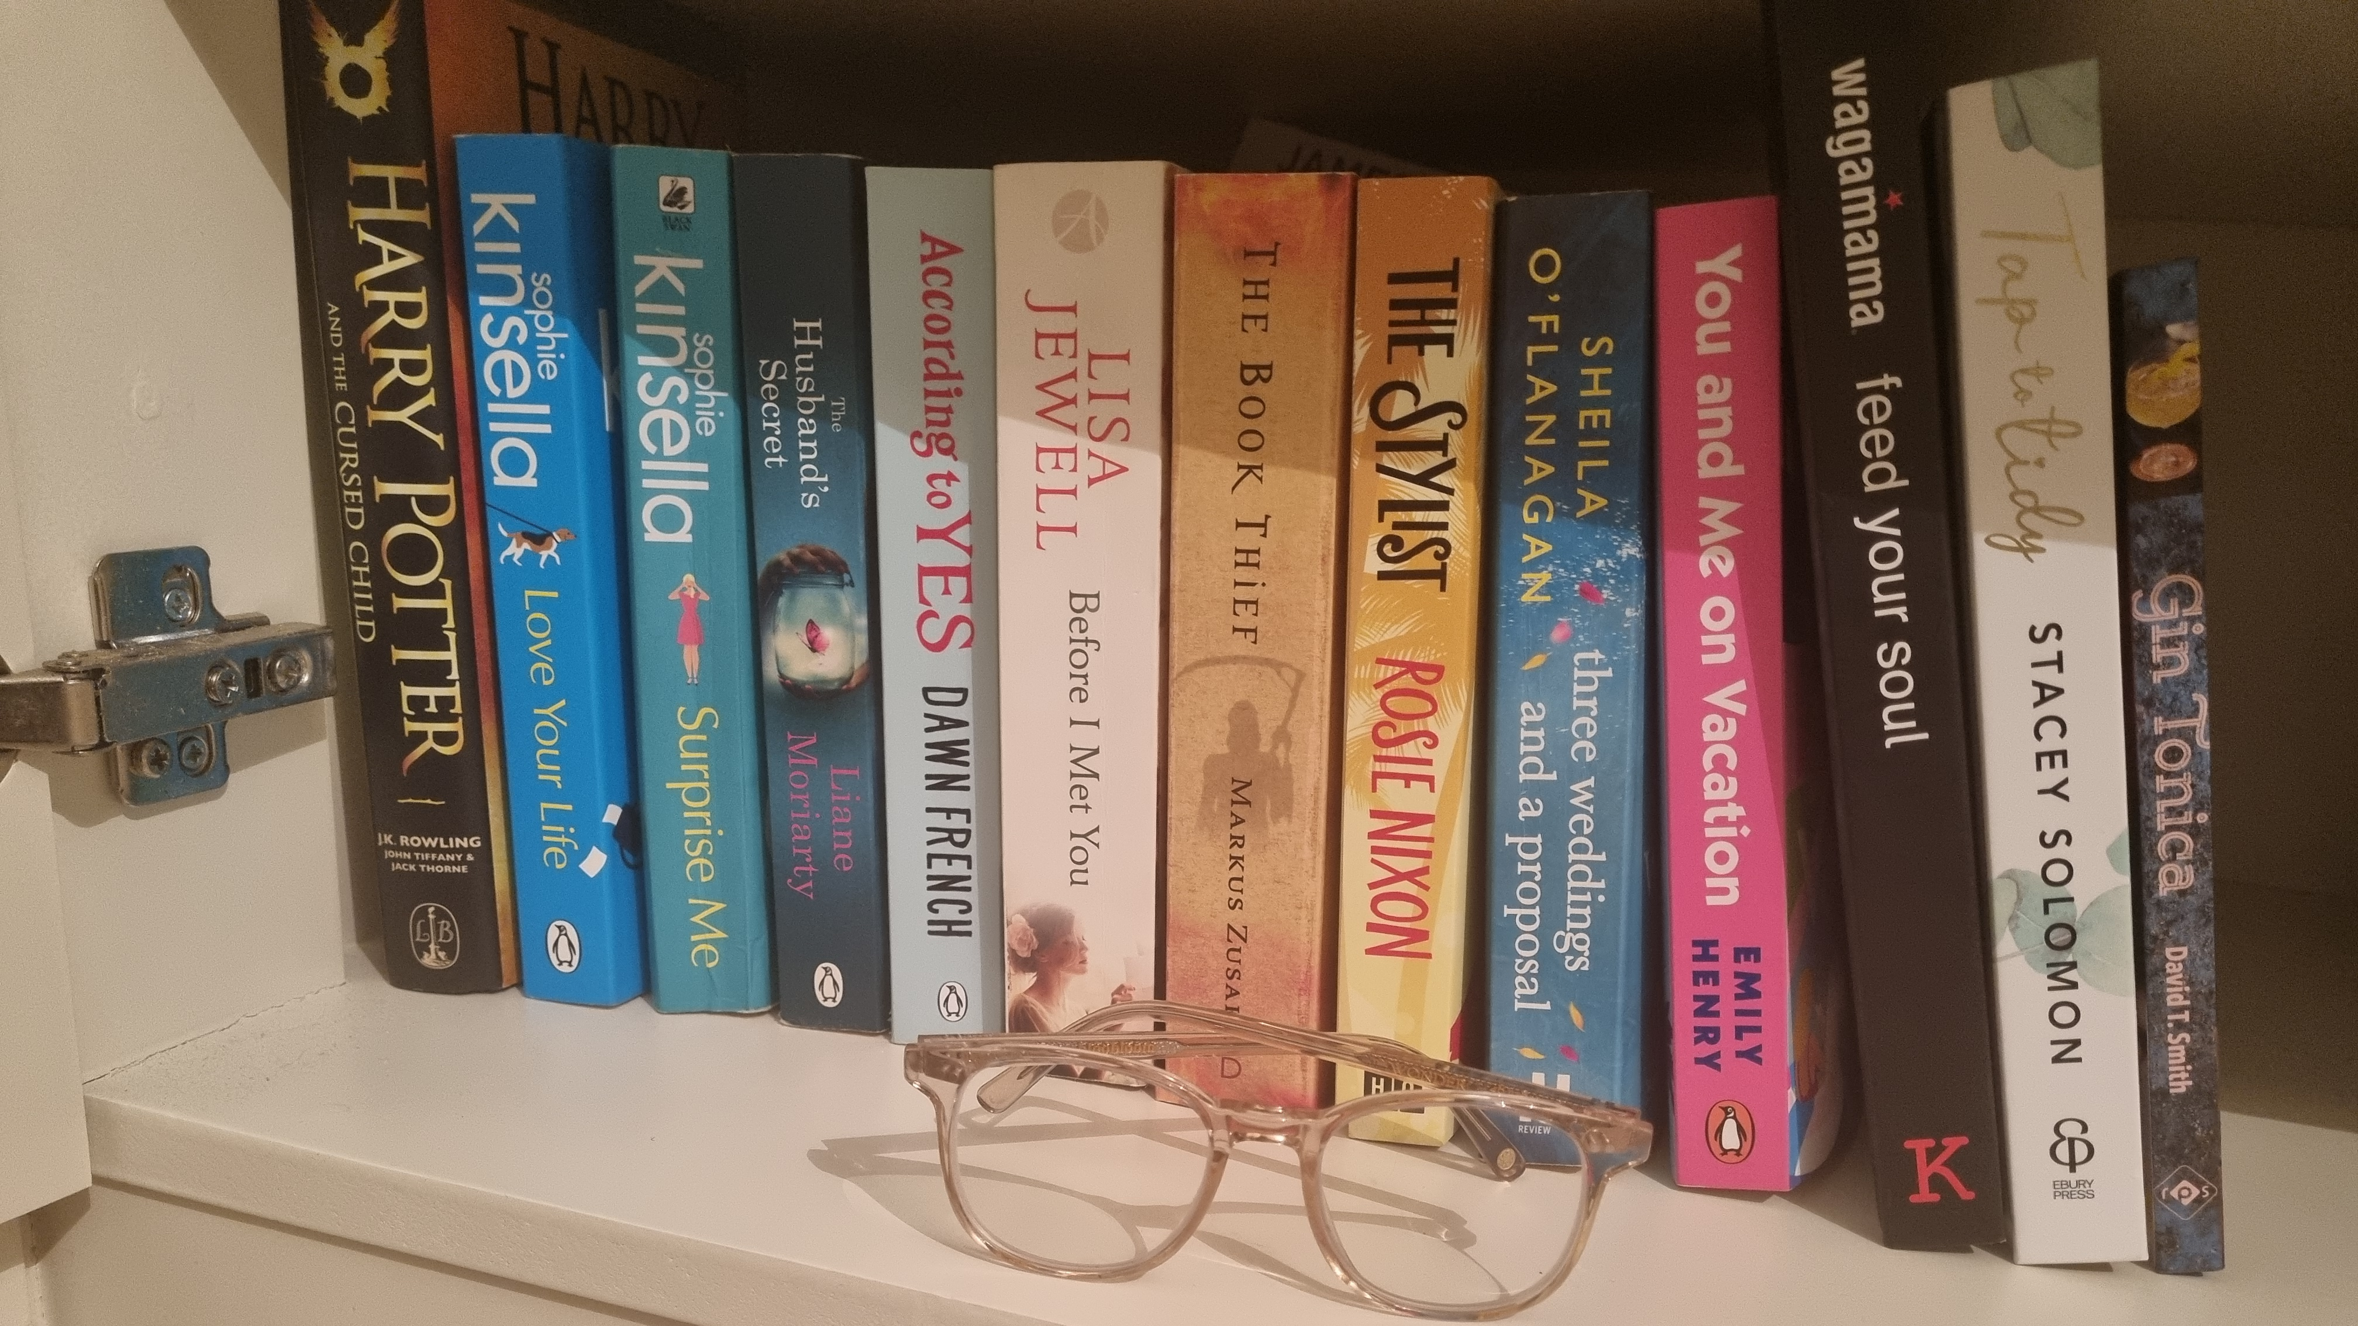
CLUE: This teacher has a tidy and clutter-free bookshelf – a bit like her classroom!
Notes:
Hannah

Slide 13
Answers
Mrs Fung
Mr Loveridge
Miss Stanley
Mrs Geddes
Mrs Cole
Miss Rudkin
Mrs Hollick
Mrs Vickers
Mr McTaggart
Mr Williams/ 5W
Mrs Smith
Let Mrs Smith know your class score!

