Slide 1
E-Safety Workshop
Keeping children safe and happy online

Slide 2



Technology is changing quickly

Slide 3
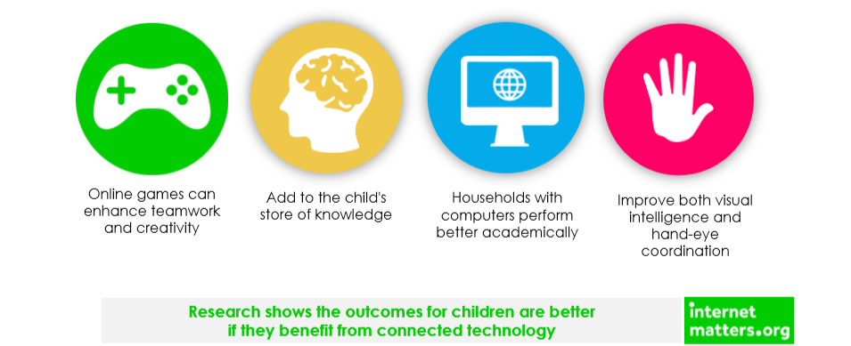
There are lots of benefits to letting our children use the internet

Slide 4
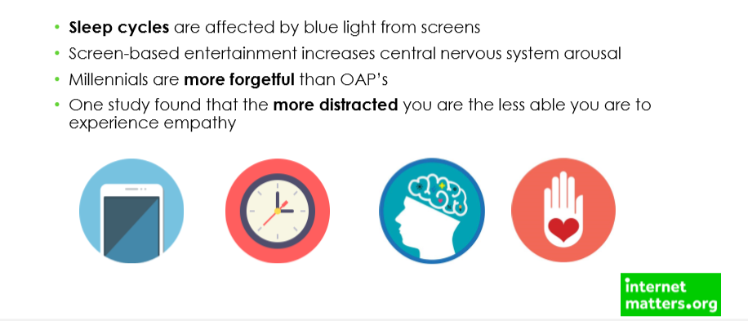
But we need to manage the difficulties
Children are often grumpy when they are not allowed on devices
Children find it hard to entertain themselves when devices are taken away

Slide 5
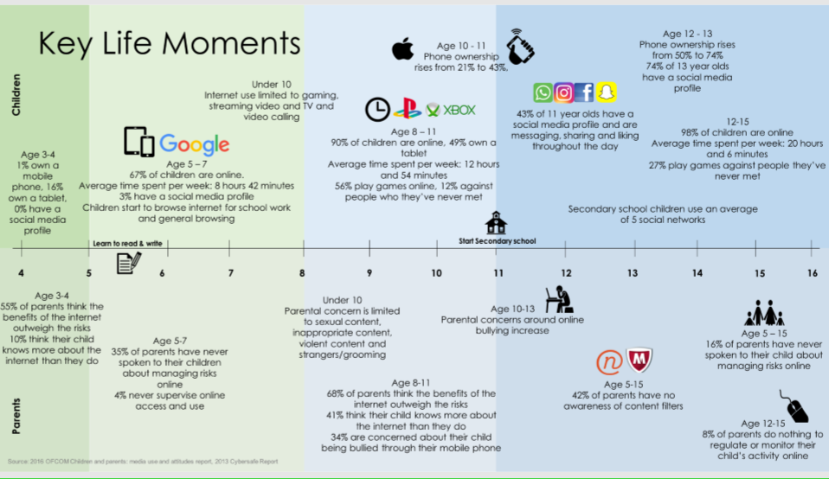

Slide 6
What are your biggest worries and concerns about your children using the internet?

Slide 7

Watch this video-
What do you notice?

Slide 8
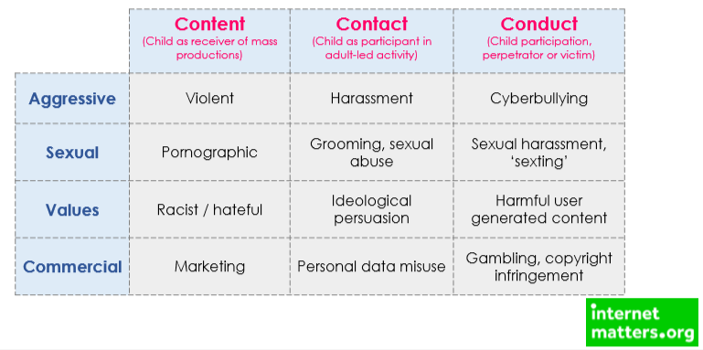
There are, of course, risks

Slide 9
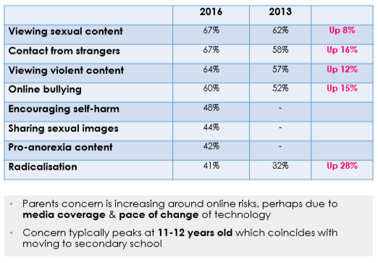
Parents’ Worries

Slide 10
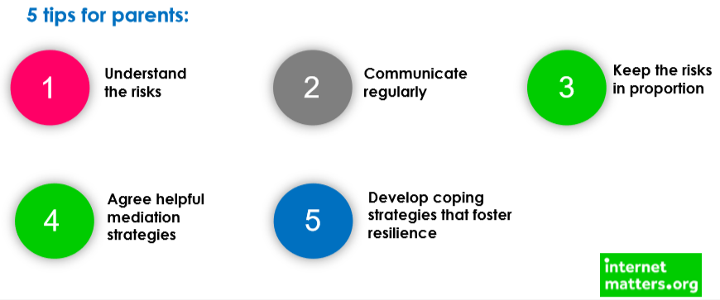
How can we limit the risks before they become harmful?

Slide 11
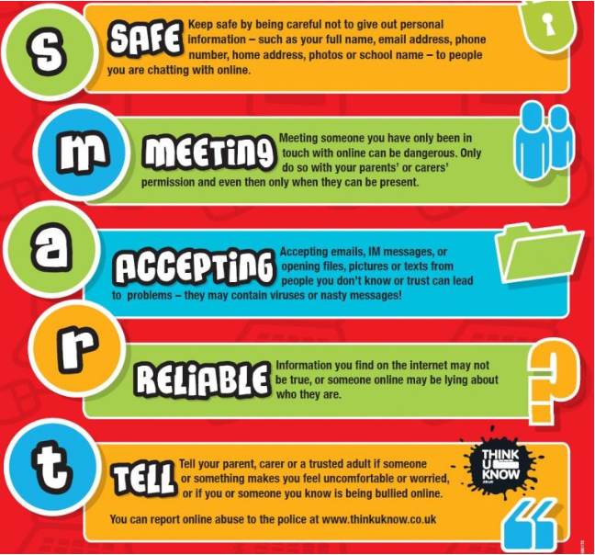
We teach children to be ‘SMART’ online
We encourage children to always tell a trusted adult if anything online makes them feel unsafe, uncomfortable or scared.
It is important that we have open communication about what our children see on line with regular discussions.
If our children think we are going to get cross and immediately take their technology away from them they are less likely to tell us anything and could become more isolated.

Slide 12
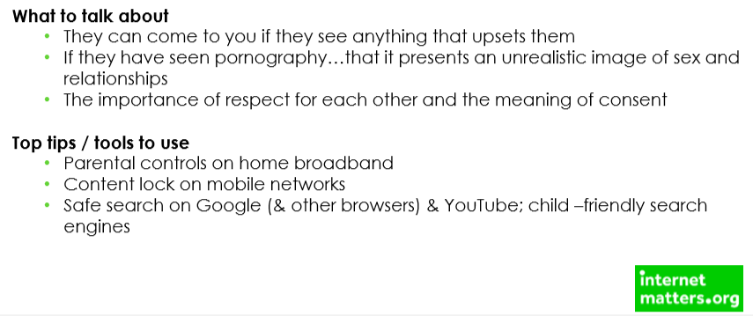
Dealing with inappropriate content

Slide 13
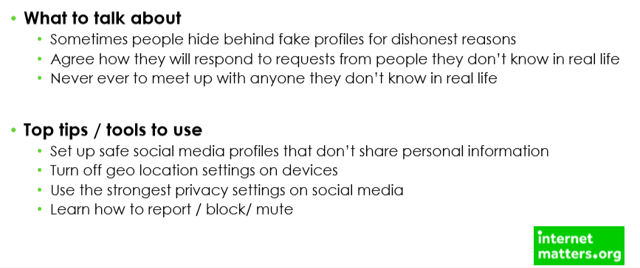
Dealing with inappropriate contact

Slide 14
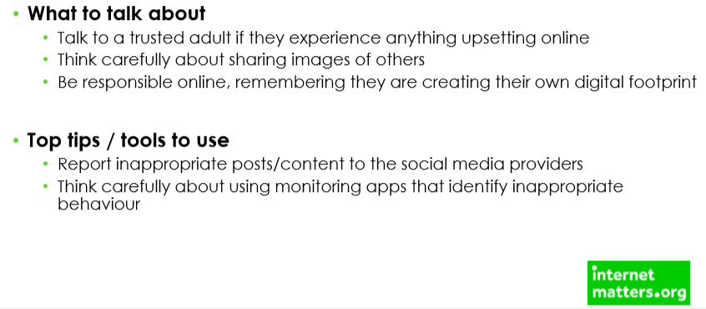
Dealing with inappropriate conduct (cyber bullying)

Slide 15
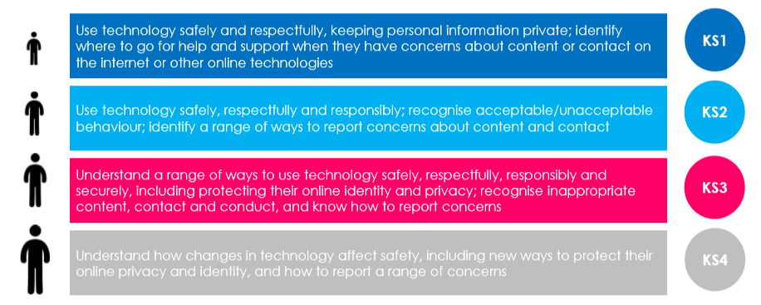
What do we teach in school?

Slide 16

As well as…

Slide 17
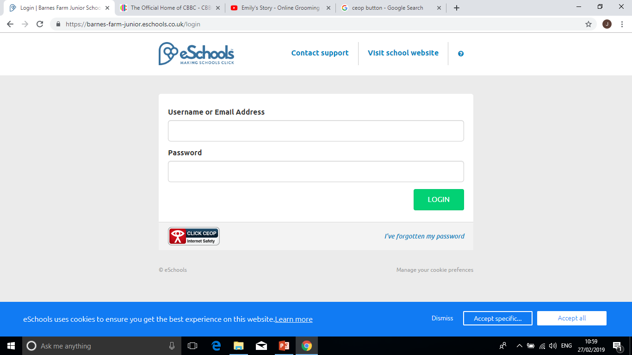
We teach children to use the CEOP (Child Exploitation and Online Protection Centre)button
The CEOP button is an asset of the National Crime Agency. It provides access to an online mechanism for reporting known or suspected child sexual exploitation or child sexual abuse directly to CEOP.
We encourage children to use this to report any unsafe or uncomfortable activity as well as always telling a parent or trusted adult.

Slide 18

The CEOP button is not always accessible
In school we also encourage children to tell a trusted adult as soon as something makes them feel unsafe or uncomfortable. As teachers, we tell children they can come to us if they are worried about talking to their parents. We will always do our best to help them speak to their parents.
If the children are too worried to speak to any of their trusted adults and there is no CEOP button,we encourage them to phone Childline.

Slide 19
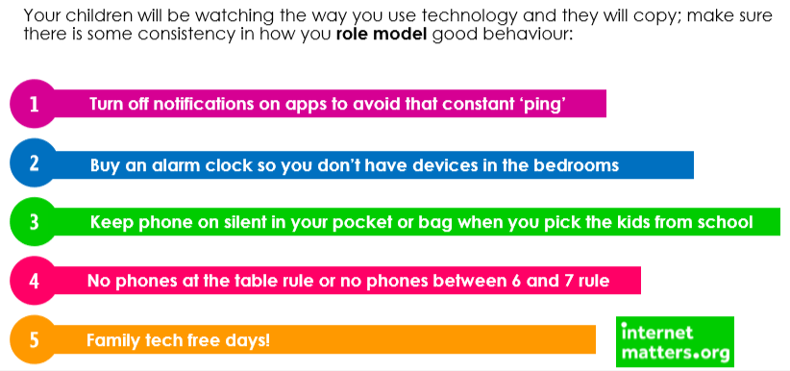
How to limit screen time

Slide 20
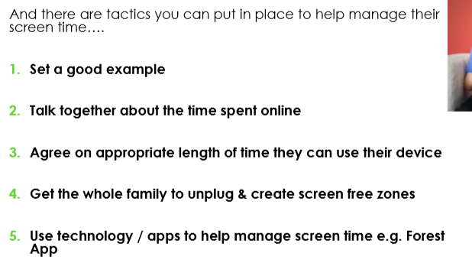

Slide 21

Points to remember
Try to have frequent chats about what kind of things children are doing online.
Try to always listen and be available.
Try not to panic and completely ban children from apps or devices.

Slide 22



Useful websites
Common Sense Media
Safety Net Kids UK

