Slide 1
Years 3, 4 & 5 home school work examples

Slide 2
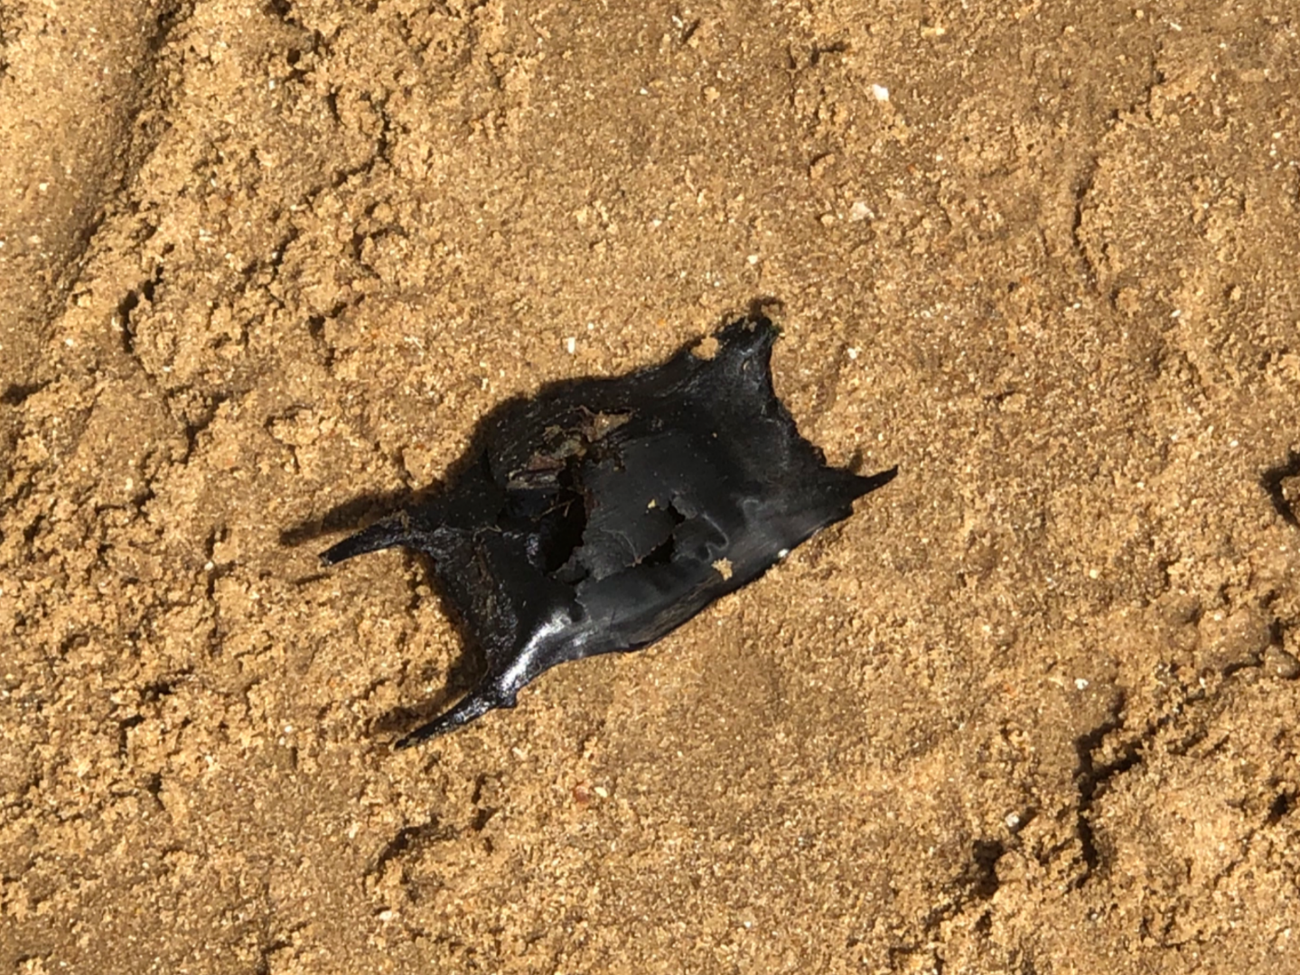
Archie’s (Year 3) mermaid purse

Slide 3
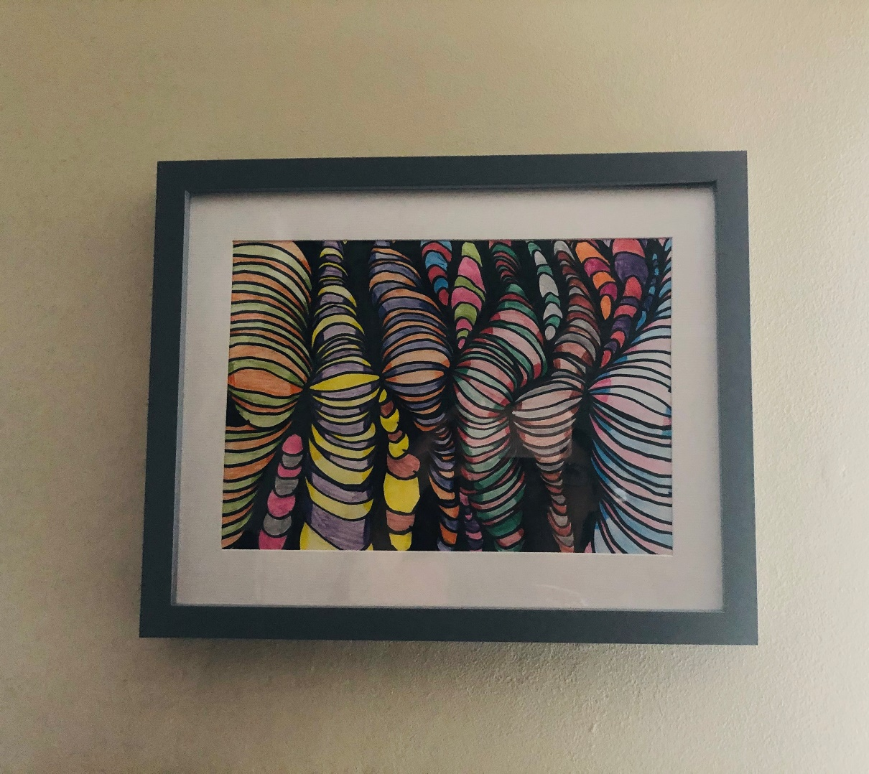
Ethan H’s (Year 4) art work was so good that his parents rightly decided to frame it!

Slide 4
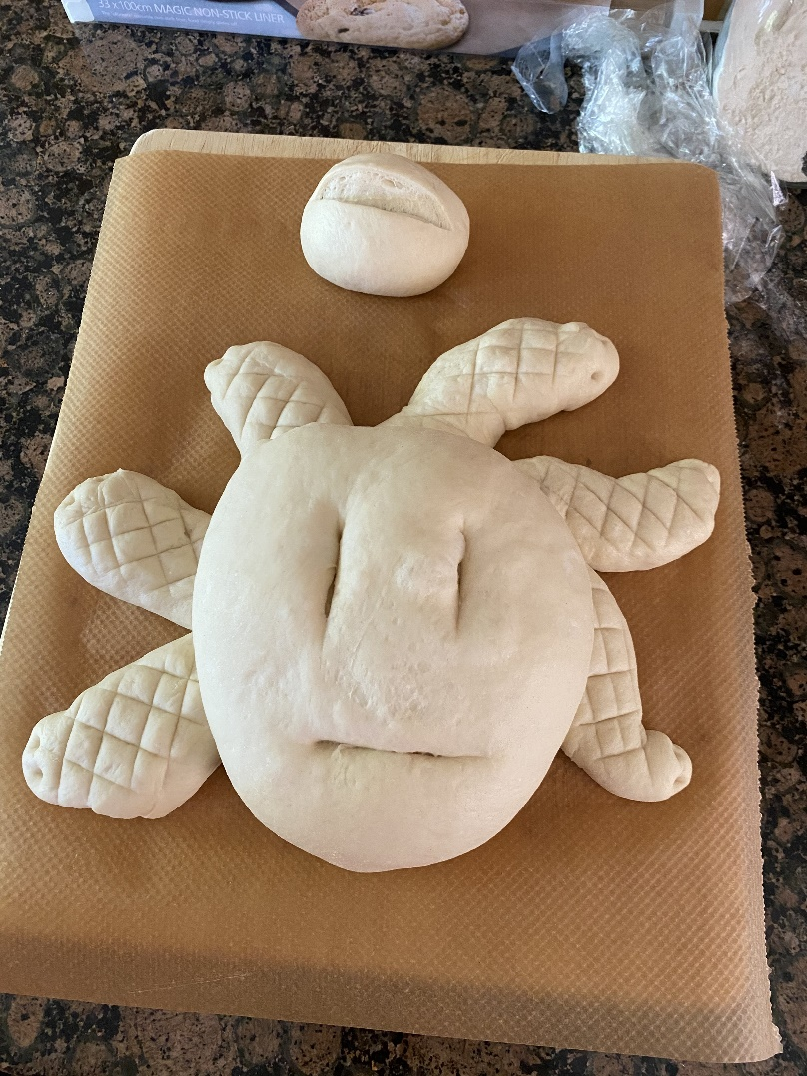
Emmeline (Year 3) created a Medusa inspired bread head as part of the Ancient Greeks topic

Slide 5
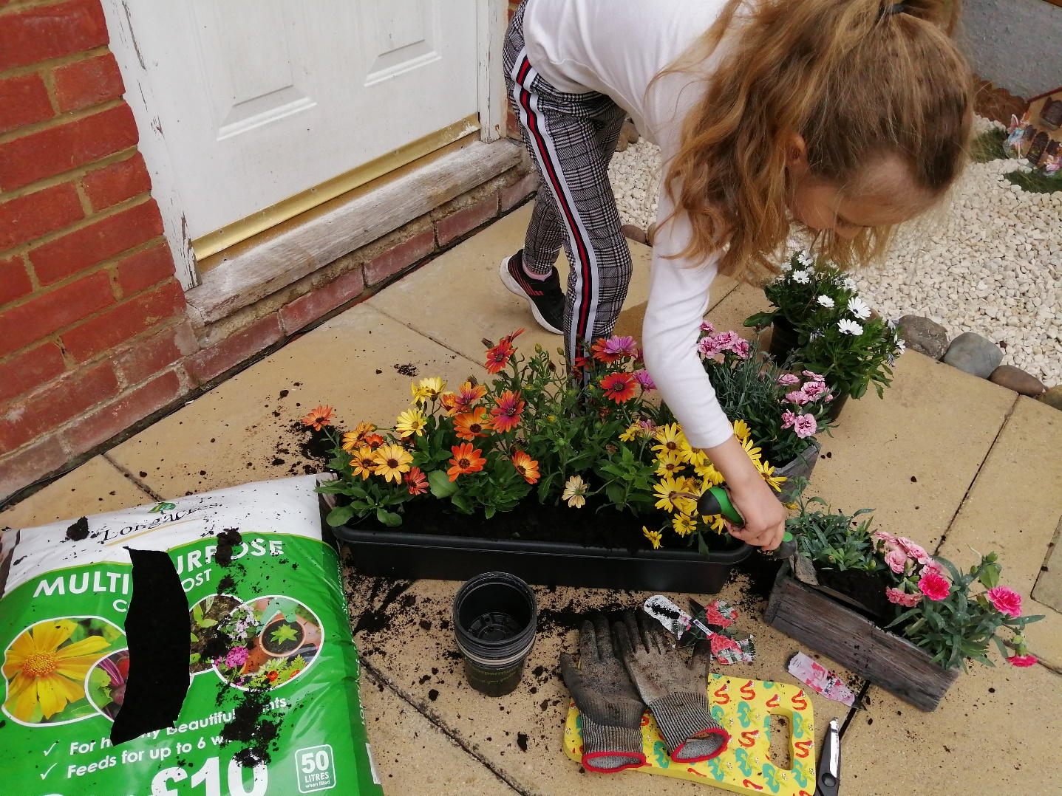
Halle (Year 4) has discovered a new love of gardening and has grown some fantastic blooms!

Slide 6
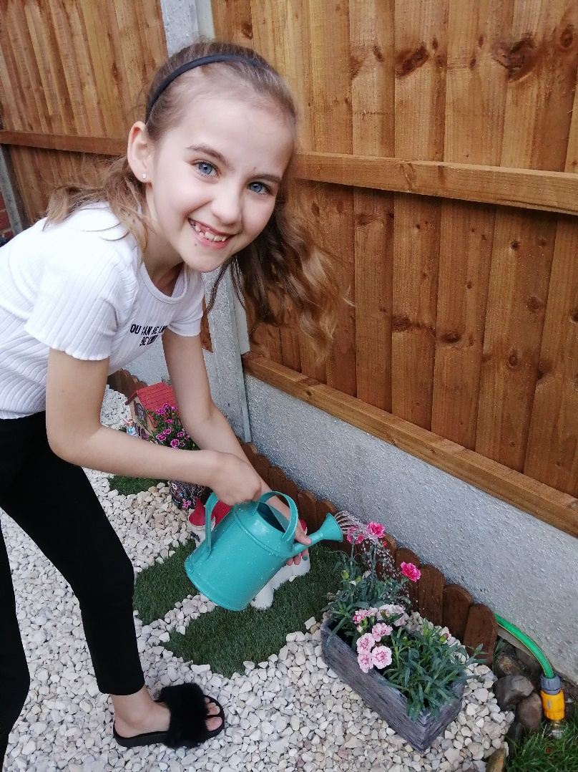
Here is Halle again in her garden

Slide 7
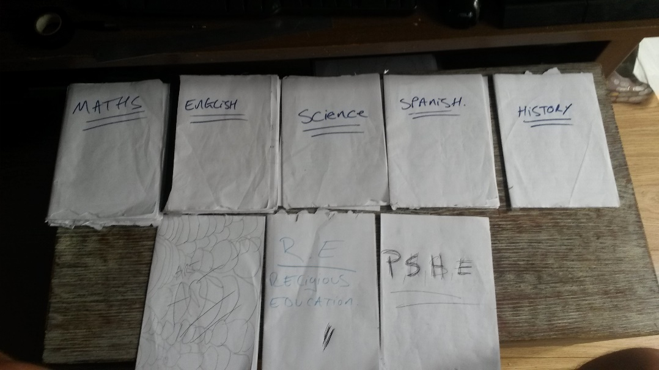
Jak (Year 3) sent 38 pieces of home schooling examples in one week!

Slide 8
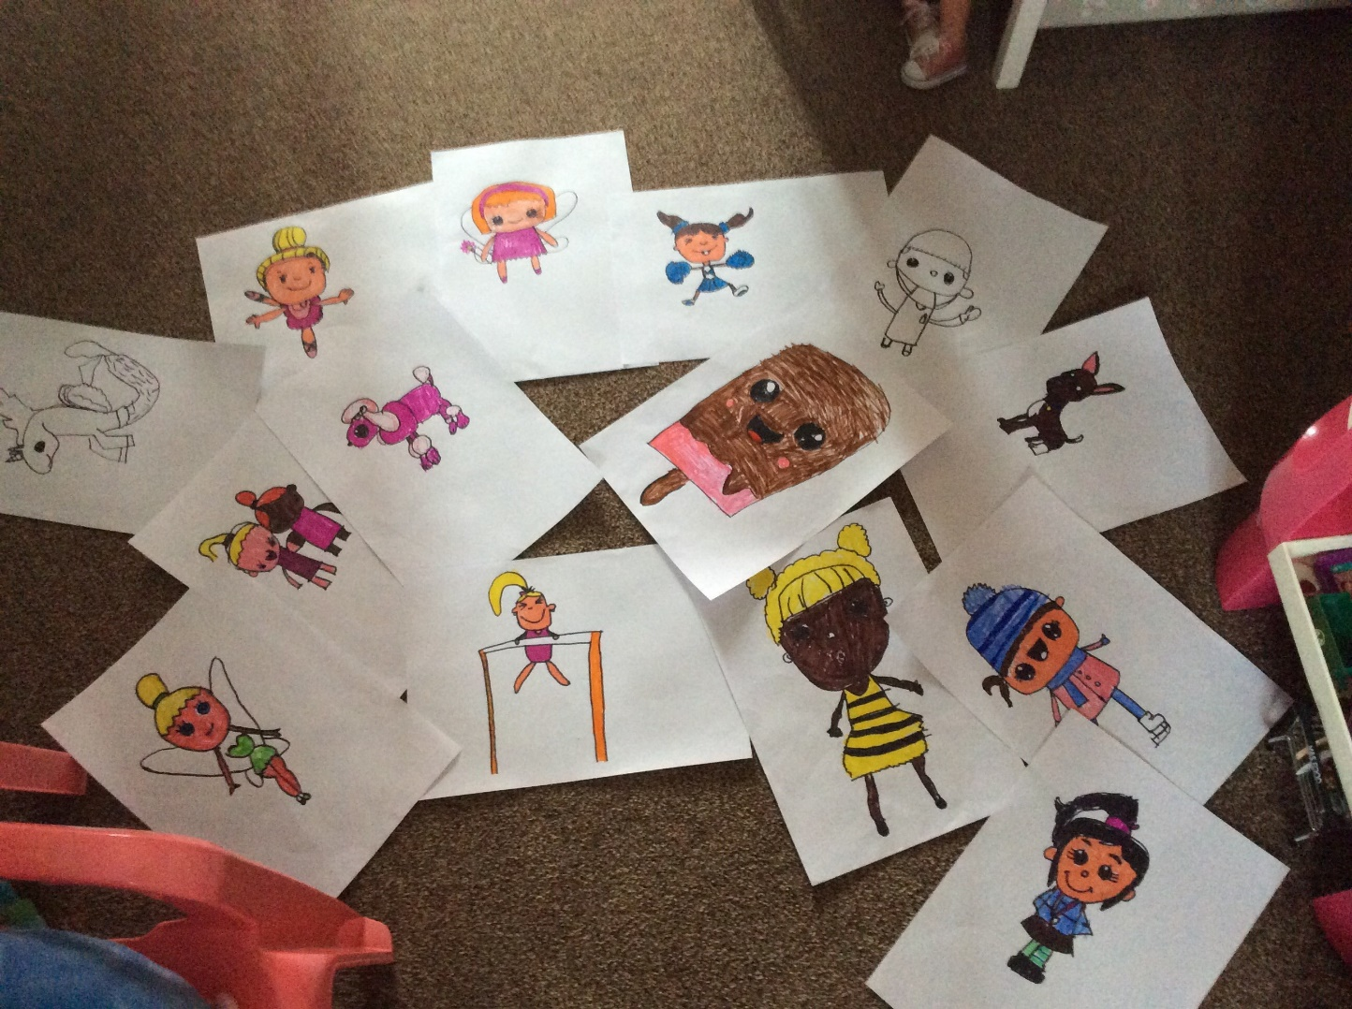
The Art for Kids hub has been a real hit with Ellen (Year 3)

Slide 9
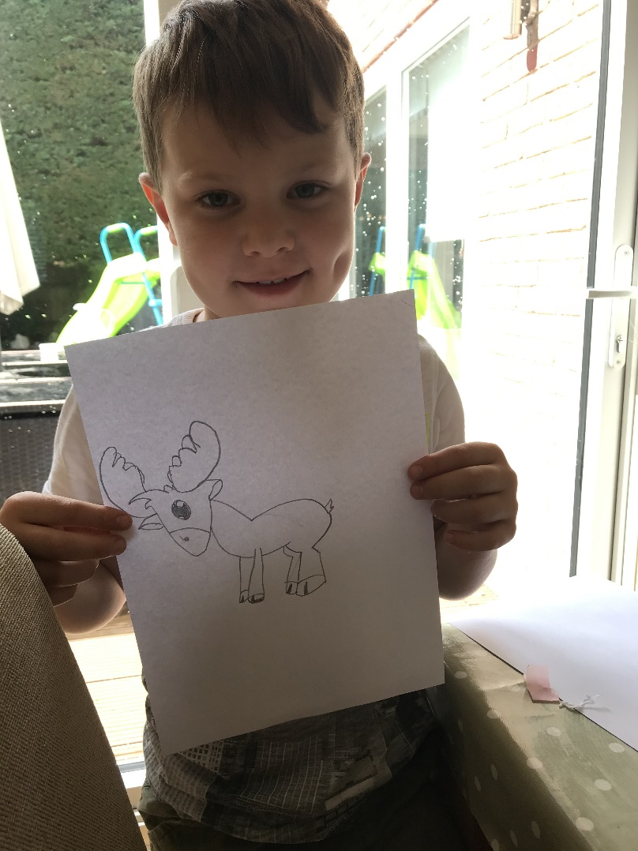
Toby (Year 3) competing with his brother…

Slide 10
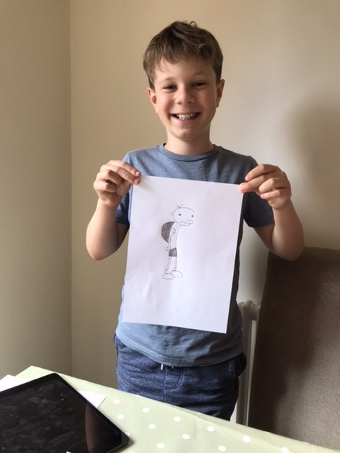
…Harry (Year 5) – both excellent artists!

Slide 11
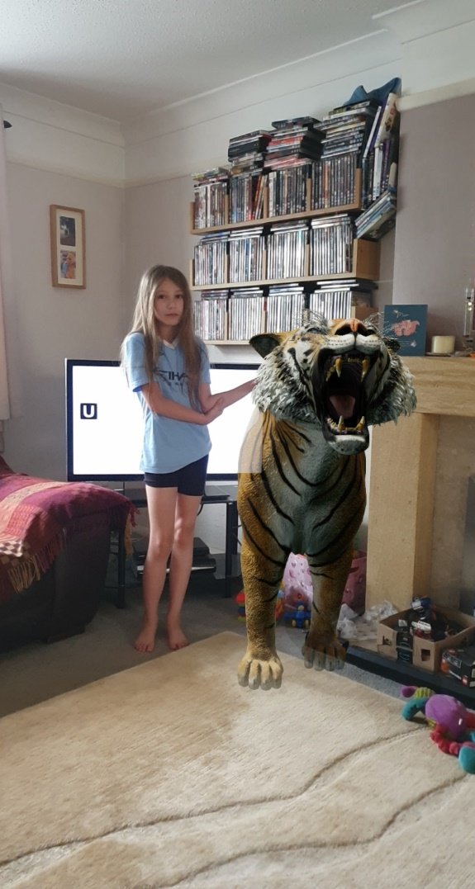
This is the tiger who came to Laura’s (Year 3) tea!

Slide 12
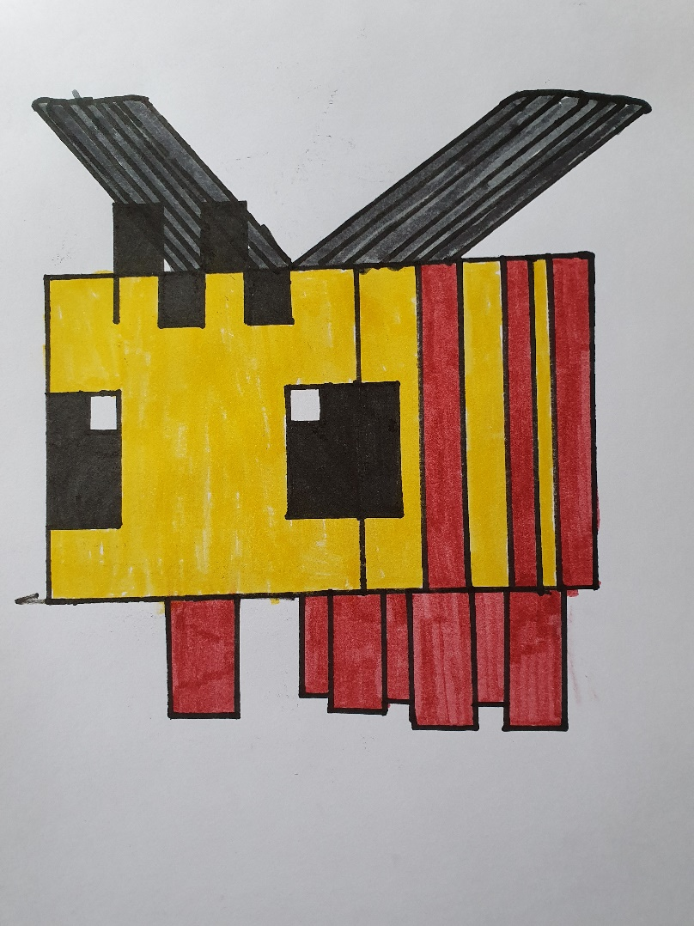
William (Year 5) has been inspired by the Art for Kids hub

