Slide 1
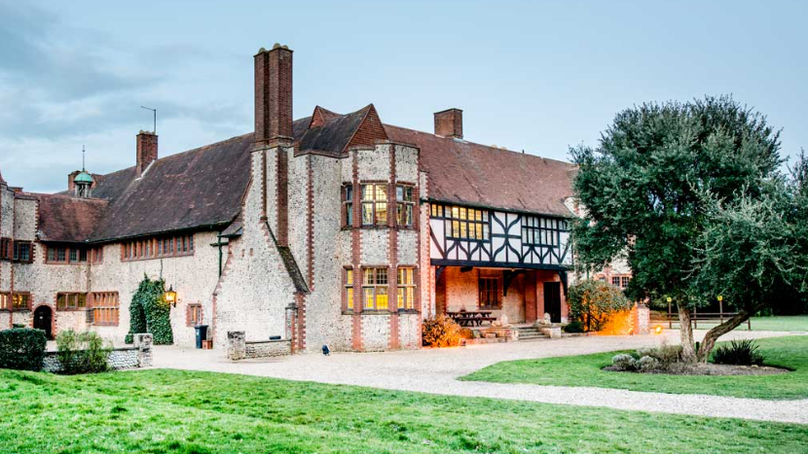
Kingswood 2023
15th October – 18th October

Slide 2
Key Info
Send back Medical info form
Arrive on Sunday at 10:30am – straight onto coach (don’t arrive too early or late!)
Packed lunch needed
Arrive back normal end of school time on Wednesday
Updates posted on Twitter (X) @barnesfarmjnr
Communication – School Office or remotesupport@barnesfarm-jun.essex.sch.uk

Slide 3
Staff Attending
Mr McTaggart (Group Leader)
Mrs Vickers (Deputy Leader)
Mr Andrews (Chair of Governors)
Mrs Smith
Mrs Dutton
Mrs Wye (First Aid)
Mrs Kersey (First Aid)
Mrs Hartley (Parent volunteer)

Slide 4
Where are we? Overstrand Hall Kingswood centre NR27 0JJ

Slide 5
Activities
Blend of adventurous and team-building activities led by qualified instructors and accompanied by school staff.

Slide 6
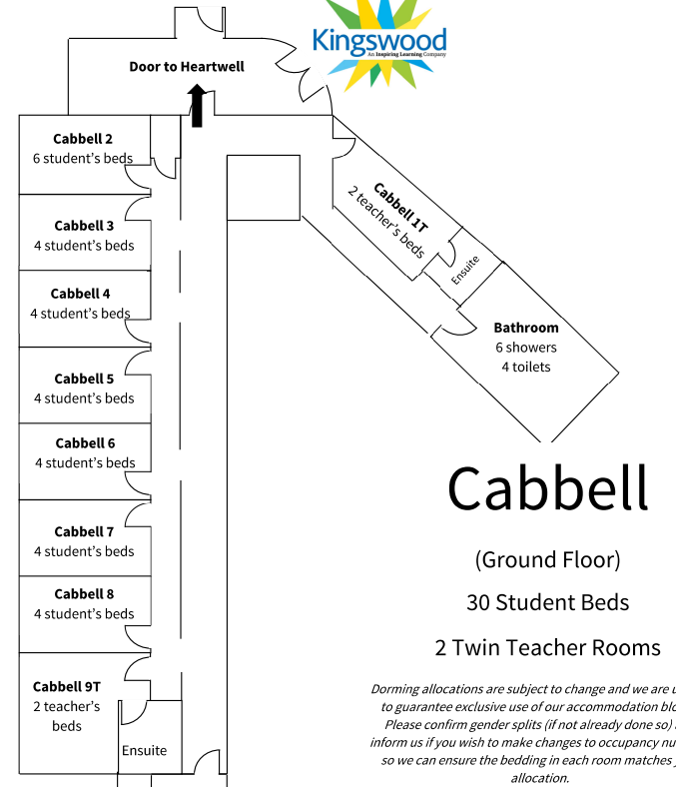
Accommodation
Three main areas (Cabell, Haylett and Heartwell)
Boys/Girls separated
Ensuite facilities or right next door
Bedding all provided

Slide 7
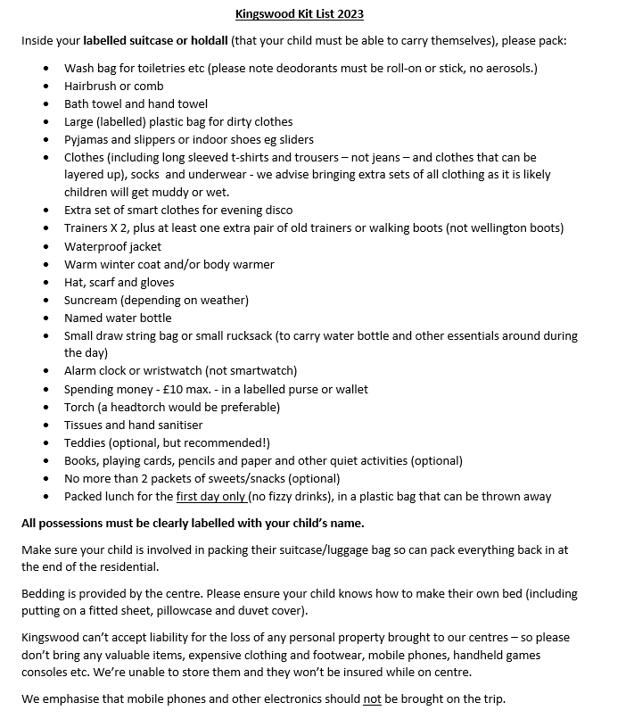
Kit List

Slide 8
Other information
Behaviour expectations on residential
No phones/smartwatches
Pocket Money - £10 maximum
Photographs – can be accessed by the children through their Office365 account

Slide 9
Thursday 19th Oct and other arrangements
Thursday 19th Oct optional later start at 10:30am (or normal 8:45am time but not in between)
Report on Studybugs if coming in for later start – IMPORTANT!
PE kit to be worn on Thursday (PE pm)
Friday 20th Non-pupil day
Other Y6 group Sporting Leadership Focus and opportunities – Archery competition etc Mon-Weds

