Slide 1
Parent Information Year 6

Slide 2
Children should bring to school each day:
Pupil passport
Reading book
Water bottle (named)
Healthy snack (e.g. fruit or vegetables)
Waterproof coat
Mobile phone (only if walking home alone; must be turned off when on school site)
In order to encourage responsibility and independence, the office will not be calling home if children have forgotten any items (e.g. homework or PE kit). Please support us with this to help prepare your child for secondary school.

Slide 3
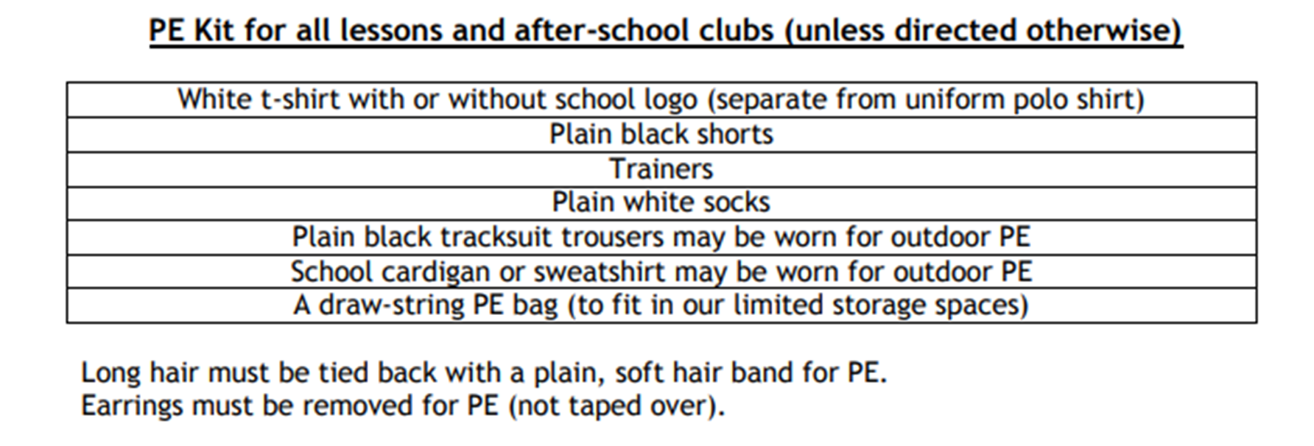
PE
PE days are Mondays and every 4th Friday – please read the weekly newsletter as dates can change.
Children can come to school wearing PE kit on these days.

Slide 4
Home Learning
Weekly Expectations before October half term:
Maths - sheet or arithmetic test (no more than 30 mins)
English - comprehension sheet (no more than 30 mins)
Reading – daily for at least 15 minutes; pupils can choose a book from the school library or one from home. Pupil passports should be signed weekly by a parent / carer. Comprehension homework counts as one read.
Spellings – practise words of the week and other spellings patterns taught in class
Practise multiplication and division facts (e.g. TT Rockstars)
Homework is set weekly on a Friday and due in the following Thursday to go through in class.
If children are finding their homework tricky, please put a note in their passport or speak to an adult in the class before Thursday so they can go through with them.

Slide 5
Home Learning
Weekly Expectations after October half term:
Rising Star Achieve 100 revision books The pupils will be given a separate workbook for GPS, Maths and reading comprehension along with a study revision book (which must be returned at the end of the year).
Reading – daily for at least 15 minutes (as before)
Spellings – practise words of the week and other spellings patterns taught in class (as before)
Times Tables
Homework is due in on Thursday; we will go through the pages that have been set during lesson time.

Slide 6
Important Dates for your Diary:
Secondary School application deadline --> 31st October
Kingswood residential --> 15th October – 18th October
Parent consultations --> 7th & 9th November
Mock SATs week --> W/C 5th February
Secondary schools allocated --> 1st March
SATs week --> W/C 13th May

Slide 7
Keeping in Touch
Parent consultations November/February
Appointments with your child’s teacher can be made via the office
Communication page in the back of pupil passport
Emails to – Remotesupport@barnesfarm-jun.essex.sch.uk
Further information can be found on the school website or in the pupil passport

