Slide 1
Mindful Monday
Monday 25th January 2021
Which activity are you most excited about?
Need more ideas? The assembly may help….

Slide 2
Screen-free Inventive Using everyday materials Indoor and/or outdoor On your own or with others Different types of learning to online

Slide 3
Being mindful
Focussing attention
On one thing at a time,
In the moment,
Non-judgementally.
Concentrate
Accepting
Focus on the here and now

Slide 4
Andy Goldsworthy
He works with materials that he finds around him
His artwork sometimes doesn’t last (living in the present)
Full of patterns and colour

Slide 5
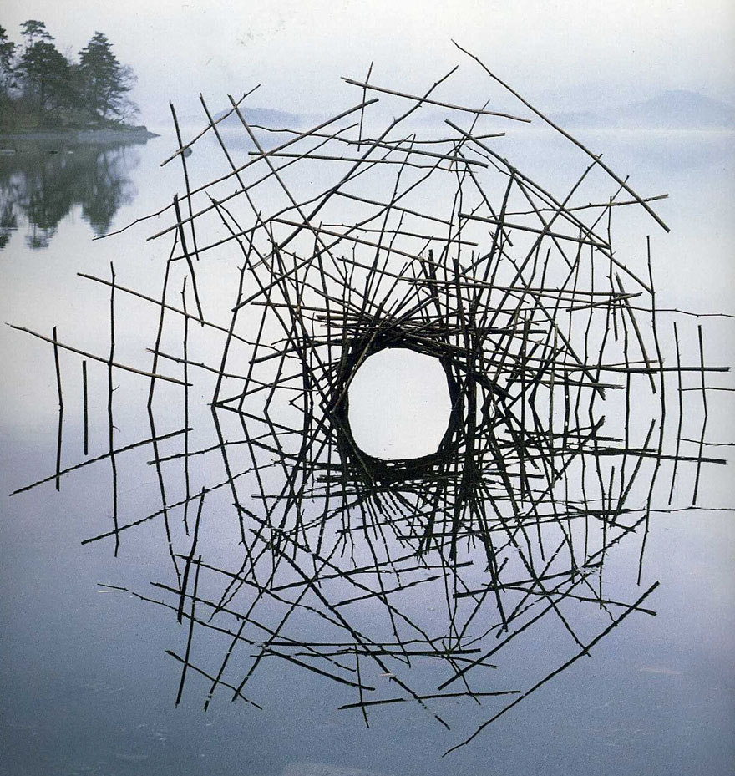

Slide 6
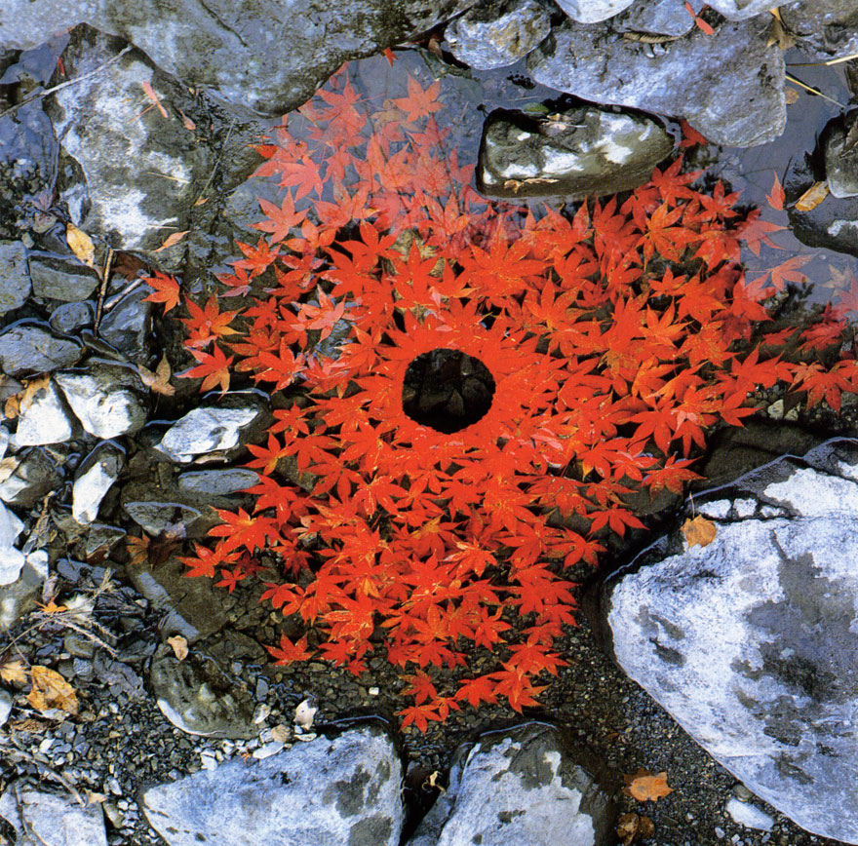
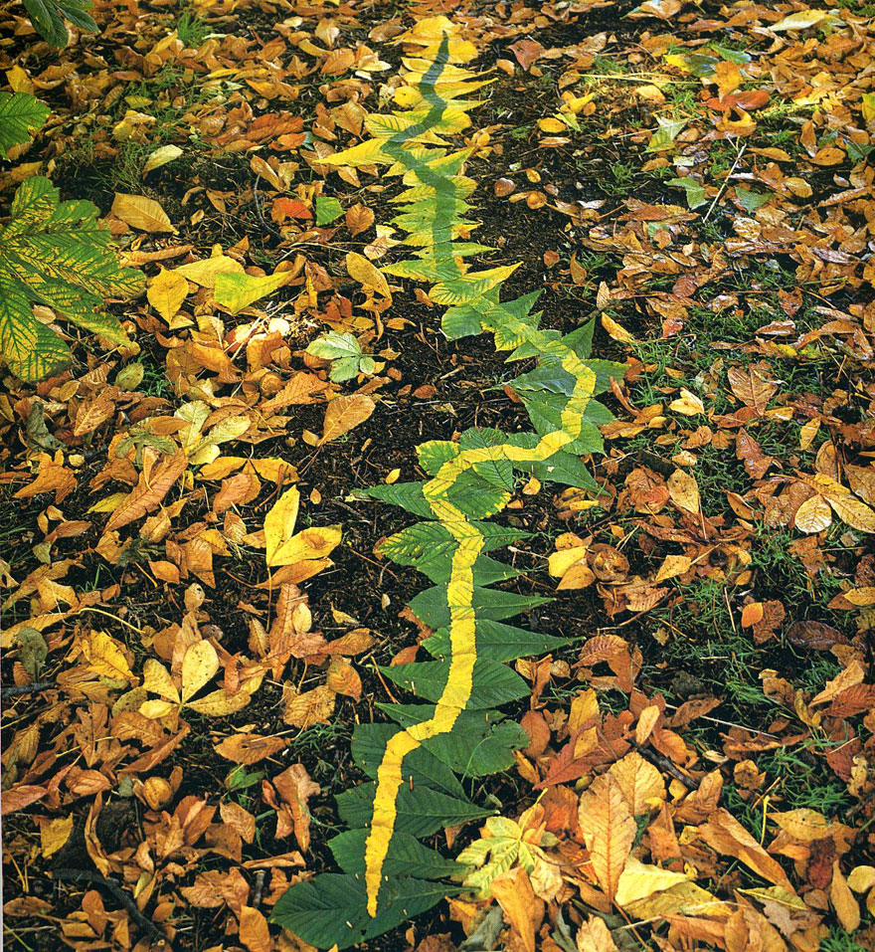

Slide 7
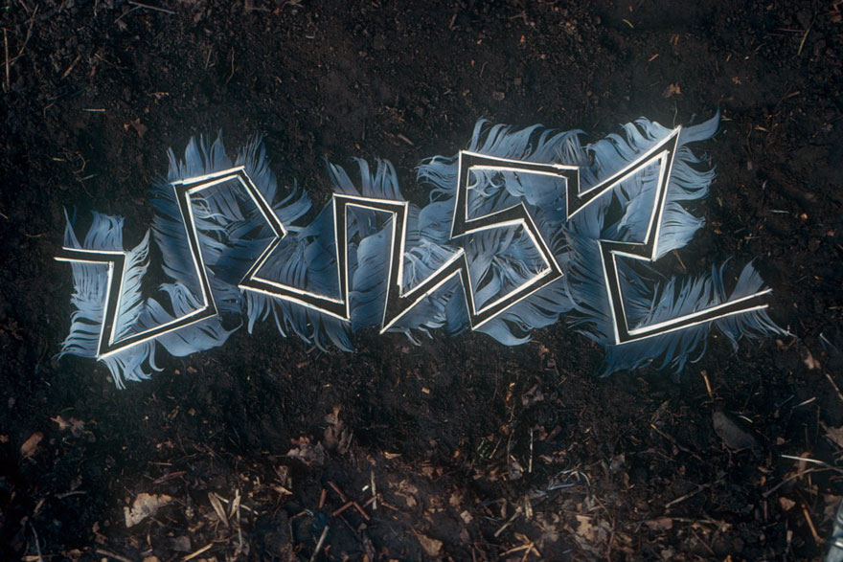

Slide 8
House Points available for tales or photos of what you have achieved
Concentrate
Focus on the here and now
Try not to think about yesterday or tomorrow
Notice how you are feeling
Accept it

Slide 9
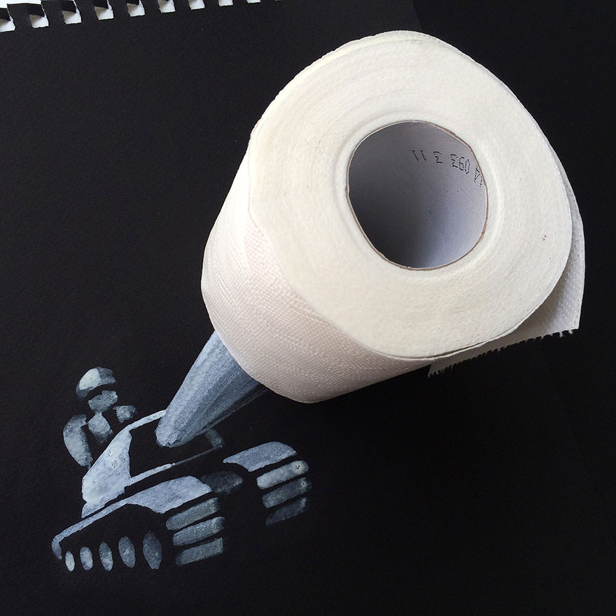
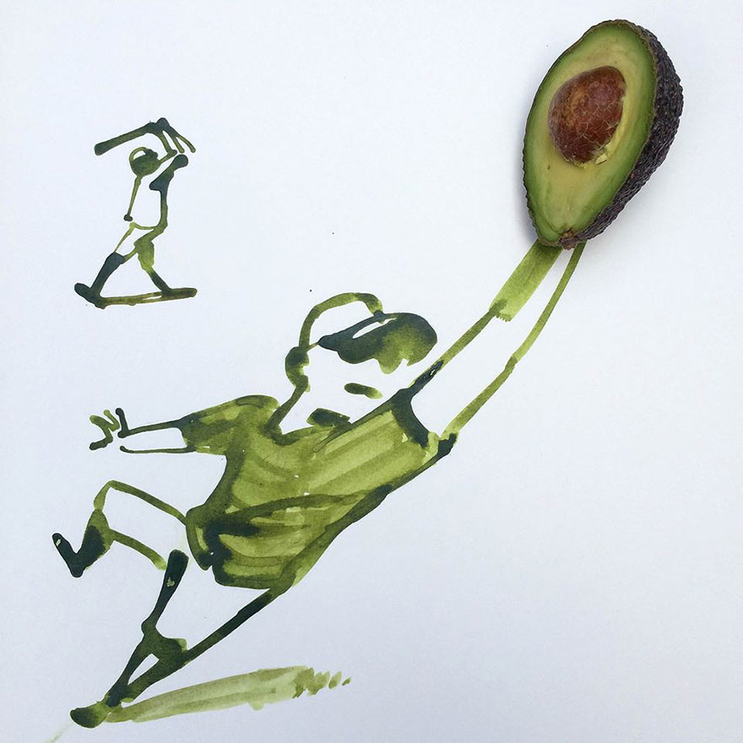
Be creative and use your imagination!
Images by Christoph Niemann

