Slide 1
Y6 Residential experience offer
Sunday October 13th – Wednesday 16th 2024

Slide 2
Why a Residential? And why then?
Sunday 13th October 2024 – Wednesday 16th October 2024

Slide 3
Kingswood Centre - Overstrand

Slide 4
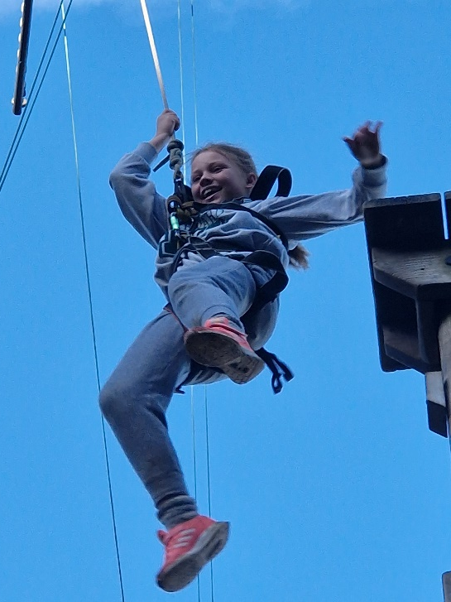
North Norfolk – CROMER (111 miles)

Slide 5
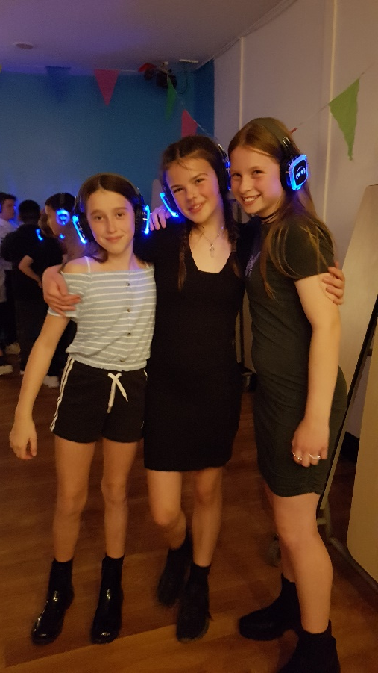

Slide 6
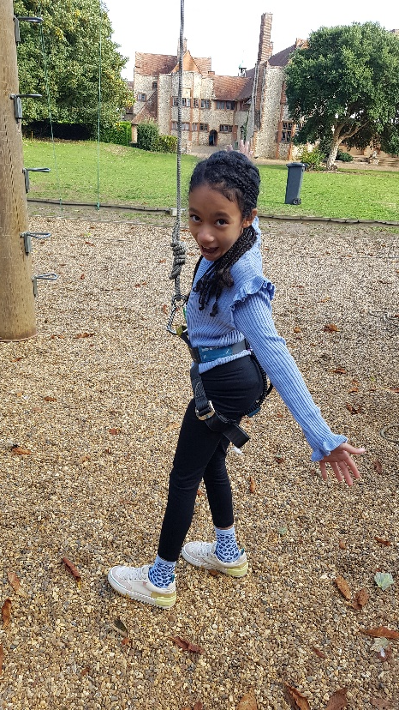
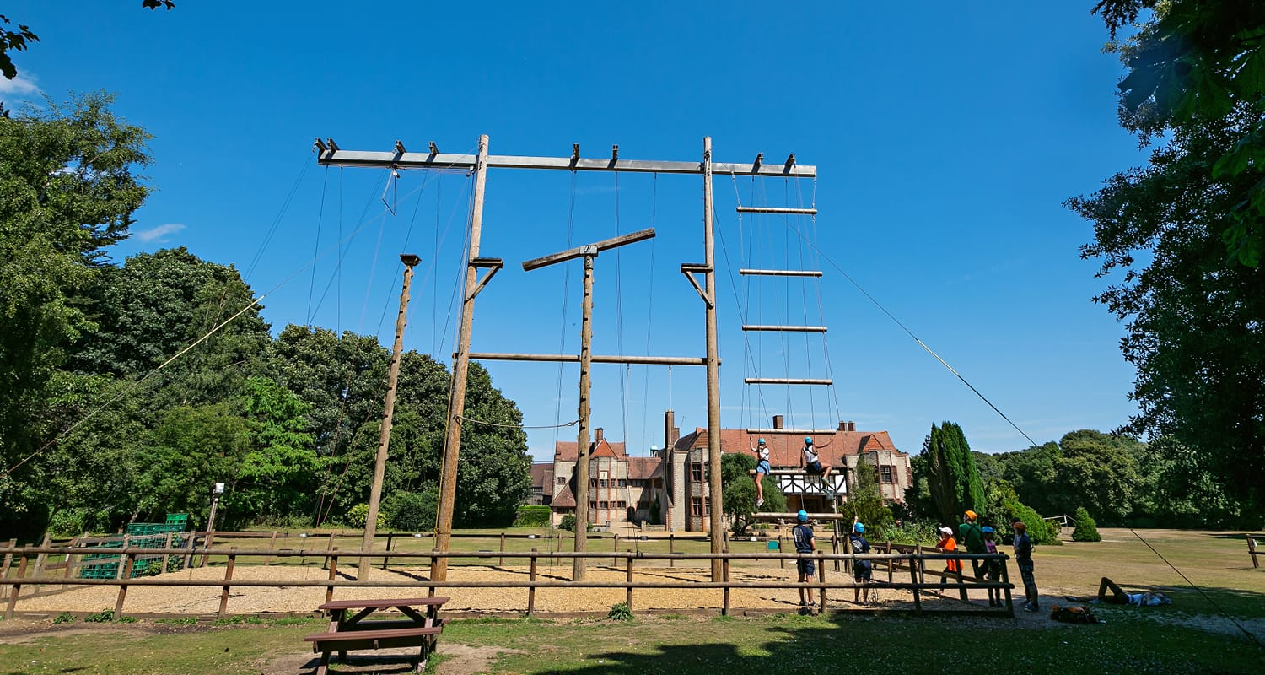
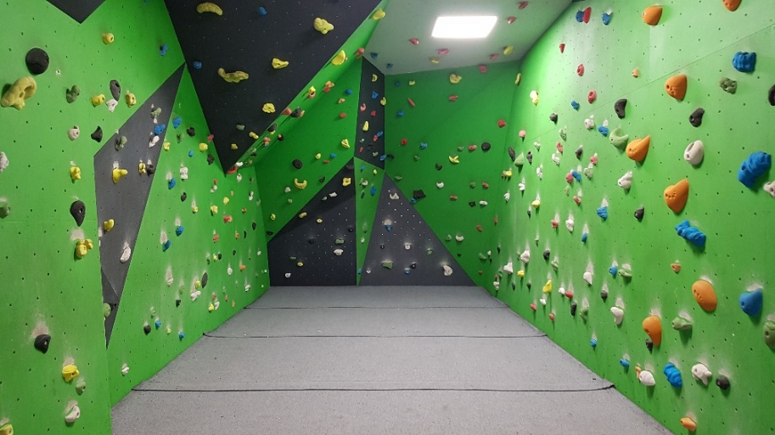
activities

Slide 7
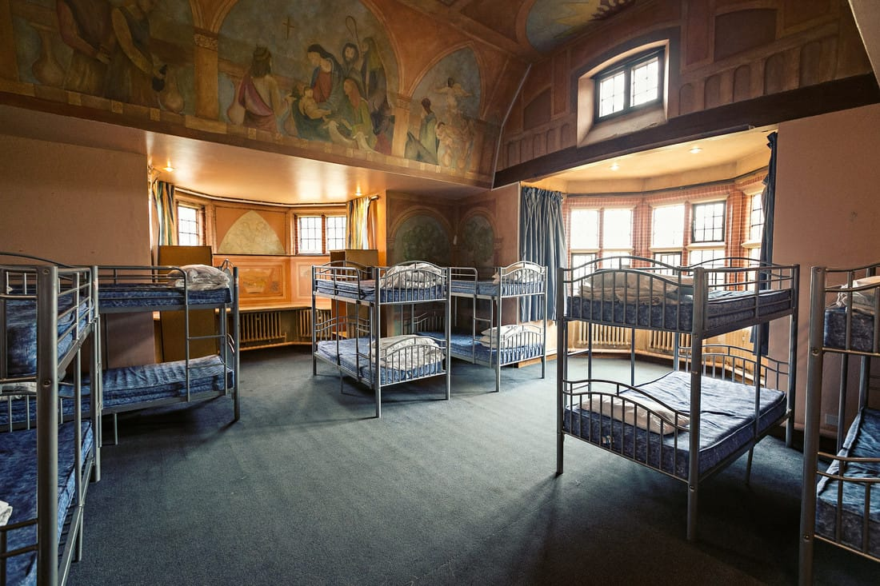
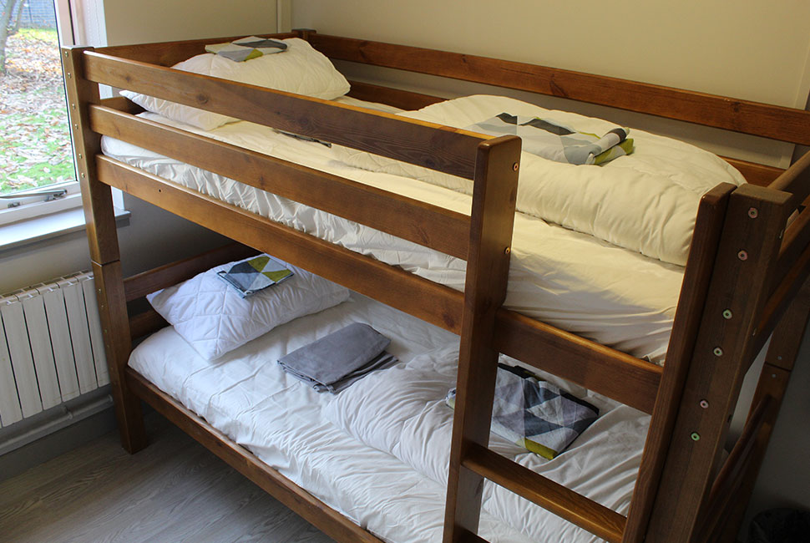
Next steps
Confirm parental consent for a place with £5 deposit (Monday 4th December 2023)
School confirms visit going ahead – December 2023
Parents pay (lump sum or flexible instalments) up to Sept 2024
Meeting in Sept 2024 with trip arrangements
Medical forms collected September 2024
Dietary/medical requirements discussed September 2024
Photos shared via Children’s Office365 accounts
Emergency phone 24/7

