Slide 1
Platinum Jubilee 1952 - 2022
Assembly Thursday 26th May

Slide 2
1952 King George VI dies Elizabeth declared Queen (aged 26)

Slide 3
Britain in 1952

Slide 4
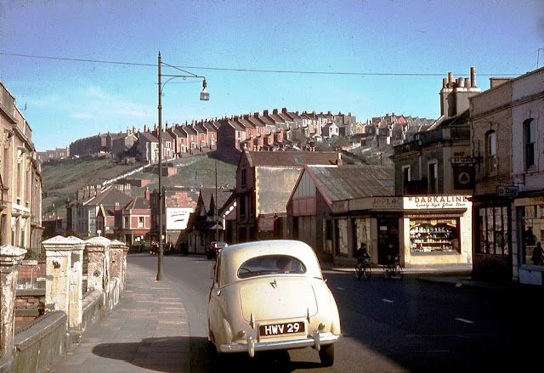
Key facts from 1952
Food still rationed
Winston Churchill PM for 2nd time
Smog in London – kills thousands
Britain developed a nuclear bomb
Newcastle win the FA cup (first foreign player scores)
Agatha Christie play – The Mousetrap begins (still running)
The first UK Singles Music Chart published
The last trams in London stop running

Slide 5
Similarities

Slide 6
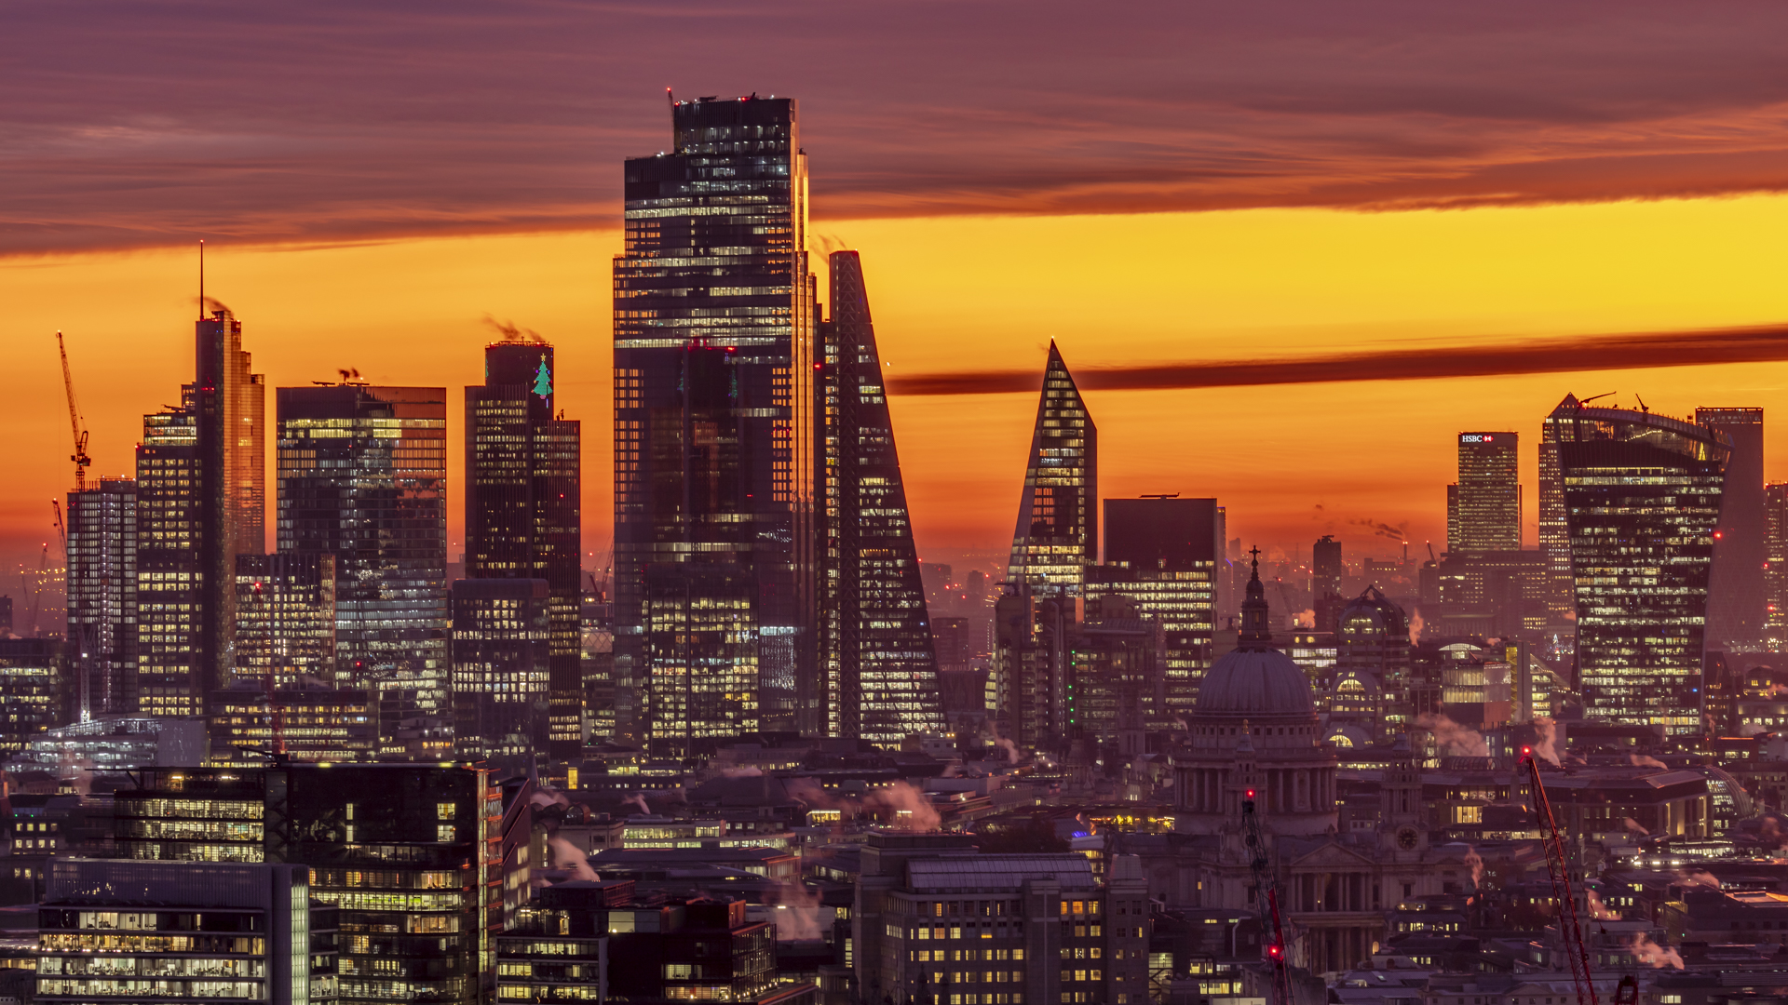
Differences – London skyline

Slide 7
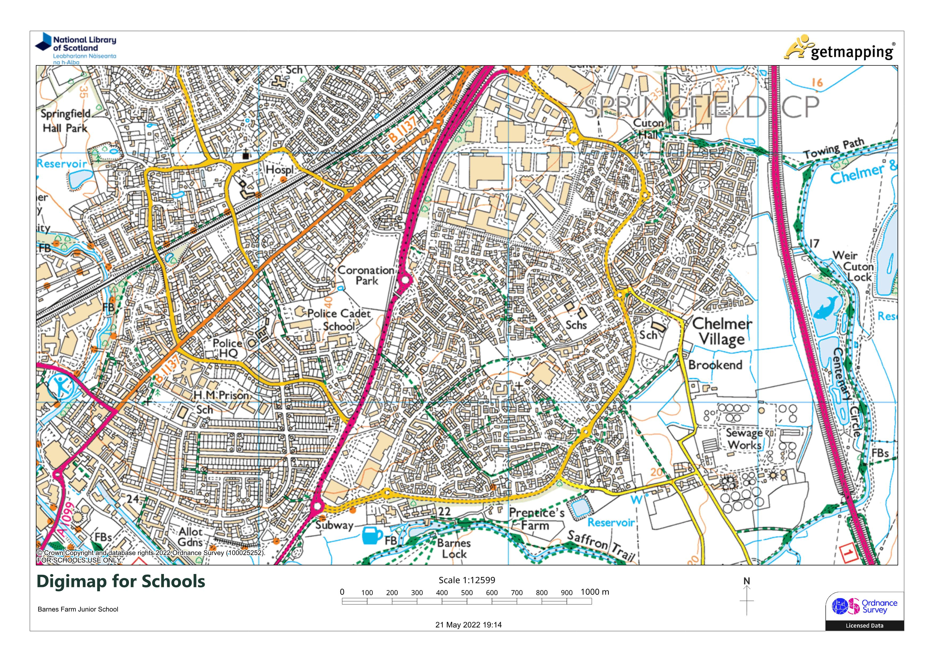
Chelmer Village

Slide 8
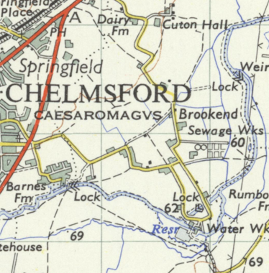
Chelmer Village
Barnes Farm existed but not as a school!
Was built in the late 1970s

Slide 9
Next 70 years? 2092
What will life be like?
Who or what will make a difference?

