Slide 1
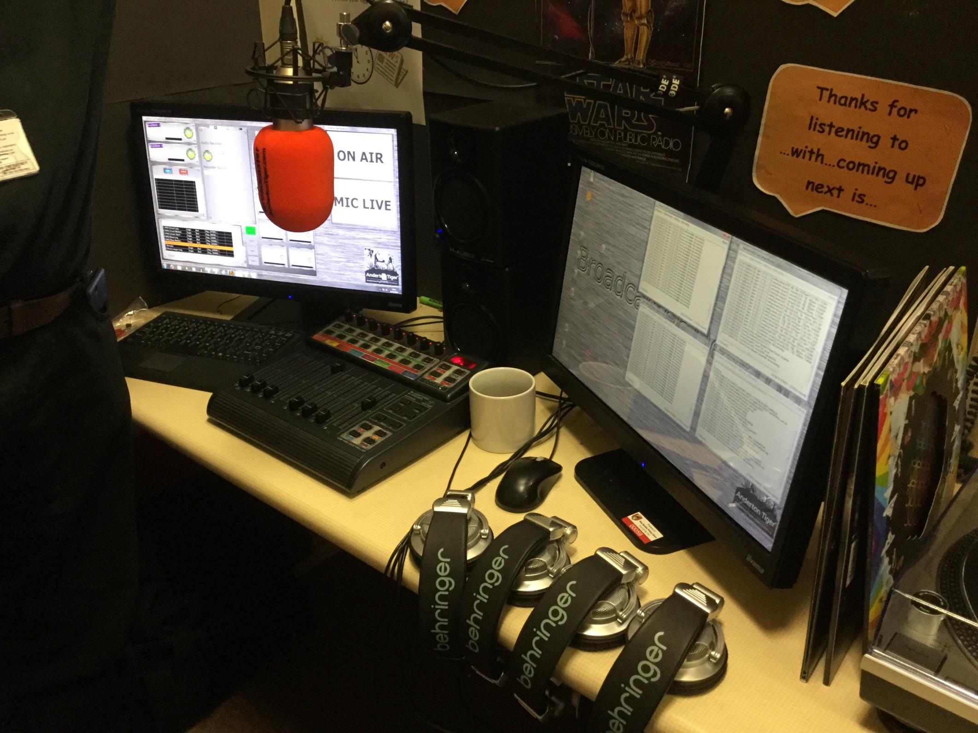
School radio station
We went to visit West Horndon School to see their Radio Station.

Slide 2
Broadcasting Live
We were shown how the radio works and even got to speak live.

Slide 3
Interview Desk
They have their own interview desk where they can interview students, teachers and special guests.

Slide 4
We were interviewed

Slide 5
Barnes Farm Radio
We really enjoyed looking at the radio station and we think the children at Barnes Farm would love it.
It would be good at Breaks.
It would help in lessons.
It will give children confidence to talk.
We could interview guests that come to school.

