Slide 1
Parent Information Presentation
Year 4
2023 - 2024

Slide 2
Meet the team.
4C
Mr Russell
Mrs Keenan
Mrs Sykes
4RG
Miss Rudkin
Mrs Grantham
Mrs Coote
Mrs Keenan
4U
Mr Upshall
Mrs Crockford
Mrs Kersey
Mr White
Year 4 LSA- Mrs Davis

Slide 3
Topic overview for the year ahead
Autumn – Why do we remember the Romans?
Roman Rescue
How to train your dragon
Roman Day – Tuesday 17th October
Spring- Geography Focus: How do European countries work together to make a better future?
Number the Stars
Sports Superstars Festival
Summer – Bright Sparks: Science/DT How has technology changed our lives?
The Wild Robot
Danbury Country Park (Habitats)

Slide 4
Rewards
Our behaviour policy is based on the positive reinforcement of good behaviour. All staff should praise children and give them encouragement when possible.
Rewards/encouragement may include:
House Points
A raffle ticket and Secrets of Success star
Class marble time
Star of the week
Feedback in books about work

Slide 5
Home Learning expectations
Children should be practising their Words of the Week spellings and times tables regularly.
It is expected that children will be heard reading/read independently, for about 10 minutes each day, minimum of 5 times a week. This should be recorded in the Pupil Passport and signed by an adult. This is then recorded by teachers and added to a class %.
Children should be using TT Rockstars regularly at home (passwords are placed in Pupil Passports).
Weekly times table test.
Maths- Weekly
Reading Comprehension – Fortnightly

Slide 6
School Equipment
In school each day pupils will need to bring their reading book, pupil passport and water bottle.
Pencil cases
Children can bring in their own pencil case with their own coloured pencils. They should be small enough to fit in trays. Children may keep pencil cases as long as they are not proving a distraction.
ALL other stationery will be provided by the school.
Fidget toys/Pop its should not be brought into school.

Slide 7
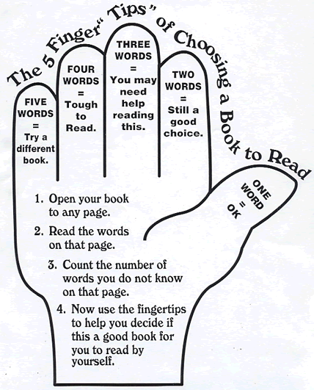
Library Books
Children are allowed to borrow books each week.
Books are checked in and out using our Libresoft software.
We expect children to look after the school books. The school may seek reimbursement for books which are lost or damaged.
Children are encouraged to use the Five Finger Check to choose books at the correct level for them.

Slide 8
Year 4 Multiplication Table Check
Online test with 25 questions administered at school.
It is the same structure to the ‘Sound check’ in TT Rockstars so it is important children have exposure to this.
Children have 6 seconds to answer each question.
Children are expected to know their tables up to 12 x 12.
The test will be in June.

Slide 9
PE Kit
Wednesday and every 4th Friday are our PE days.
Uniform- Trainers, white P.E t-shirt (with or without logo), black shorts (summer) or plain black tracksuit trousers (winter), school cardigan or sweatshirt, plain white socks.
Children may need a light jacket for outdoor games. It is advised that children bring old trainers for outdoor use, if it is muddy.
For all P.E activities:
Hair needs to be tied back and earrings must be taken out before school– they cannot be taped over. Children wearing earrings on PE days cannot participate in PE lessons.
Children are encouraged to come to school wearing their PE kits on PE days.
Extra P.E Friday
22nd September
3rd November
1st December

Slide 10
How to keep in touch
Appointments should be arranged via the office if you need to speak to a teacher.
Notes can be sent via Pupil Passports.
LSA/ class teacher can be approached in the morning, if required. This should, however, be brief.

Slide 11
Policies and Useful information
Please visit the school website for guidance on a variety of useful topics:
safeguarding
calculation policy
behaviour for learning policy
school newsletters
school meal schedule
term dates

